Slide 1
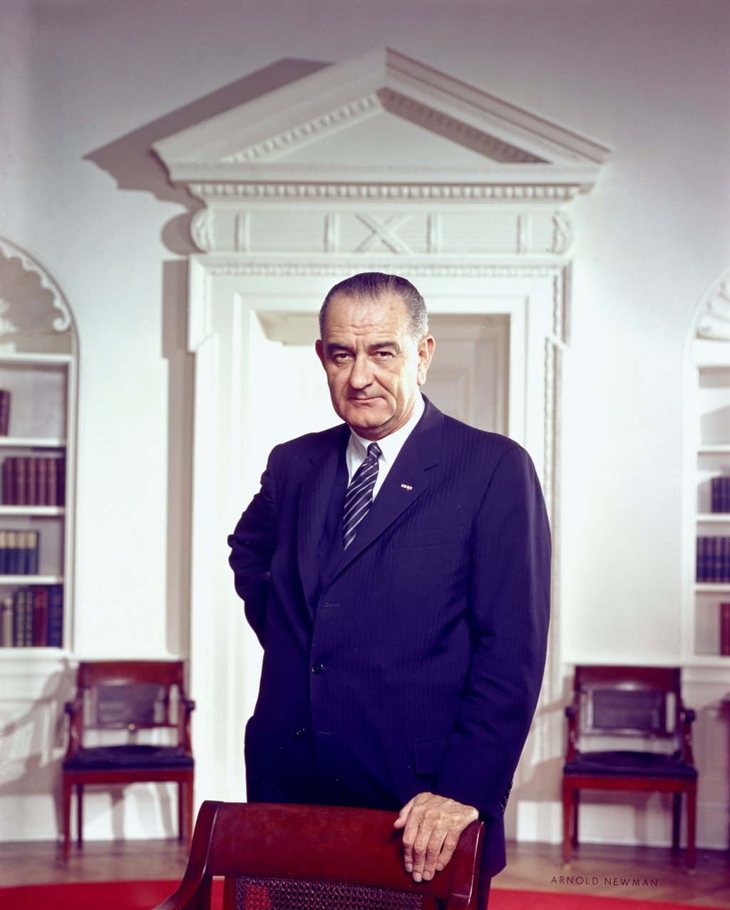
The Lyndon B. Johnson Administration
The Sixties: 1960-1969 > The Lyndon B. Johnson Administration
The Lyndon B. Johnson Administration
The Great Society
"The War on Poverty"
Commitment to Vietnam
The Election of 1964
The Civil Rights Act of 1964
The Immigration Act of 1965
Assessing the Great Society
Preventing Another Castro in Latin America
"Americanizing" the Vietnam War
The Widening War at Home
1968: The Year of Upheaval
The Election of 1968
Free to share, print, make copies and changes. Get yours at www.boundless.com
www.boundless.com/u-s-history

Slide 2
The Lyndon B. Johnson Administration
The Sixties: 1960-1969 > The Lyndon B. Johnson Administration
Johnson passed the Civil Rights Bill immediately following JFK's assassination.
Johnson was reelected in 1964 in a landslide victory.
Using the slogan the "Great Society", Johnson's domestic policy tackled civil rights, education, and healthcare among other issues.
Johnson addressed the national economy with the "War on Poverty".
Johnson escalated American involvement in the Vietnam War.
Lyndon B. Johnson, in the Oval Office.
View on Boundless.com
Free to share, print, make copies and changes. Get yours at www.boundless.com
www.boundless.com/u-s-history/textbooks/boundless-u-s-history-textbook/the-sixties-1960-1969-29/the-lyndon-b-johnson-administration-223/the-lyndon-b-johnson-administration-1245-2007

Slide 3
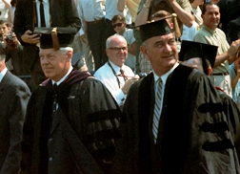
The Great Society
The Sixties: 1960-1969 > The Lyndon B. Johnson Administration
The Great Society programs addressed education, racial injustice, poverty, the environment, and health care among other issues.
This era has been described as the peak of liberalism in the United States and is compared to FDR's New Deal.
The Democratic majority in Congress allowed Johnson to make sweeping legislative changes.
The educational initiatives included in the Great Society legislation increased the role of the federal government in primary and secondary education.
In 1965, Johnson created the National Endowment for the Arts and National Endowment for the Humanities to provide funding opportunities for the development of arts and culture.
Public television and radio also emerged in this era.
The Department of Transportation was established to oversee the development of urban public transportation networks.
Consumer protection legislation and environmental protection were also prioritized by Johnson's administration.
LBJ, at the University of Michigan Commencement Ceremony, 1964
View on Boundless.com
Free to share, print, make copies and changes. Get yours at www.boundless.com
www.boundless.com/u-s-history/textbooks/boundless-u-s-history-textbook/the-sixties-1960-1969-29/the-lyndon-b-johnson-administration-223/the-great-society-1246-2515

Slide 4
"The War on Poverty"
The Sixties: 1960-1969 > The Lyndon B. Johnson Administration
As a former Texas school teacher, Johnson was exposed to extreme poverty prior to his presidency.
The Economic Opportunity Act of 1964 established the Office of Economic Opportunity, which oversaw a majority of the social programs designed to combat poverty.
Major programs that emerged during the War on Poverty included the Job Corps, the Neighborhood Youth Corps, VISTA, Upward Bound, the Food Stamp Act of 1964, the Community Action Program, and Head Start.
Health care and social security programs were also expanded in this period.
These programs waned in popularity as the nation shifted toward conservatism in the decades following the Johnson Administration.
These programs waned in popularity as the nation shifted toward conservatism in the decades following the Johnson Administration.
View on Boundless.com
Free to share, print, make copies and changes. Get yours at www.boundless.com
www.boundless.com/u-s-history/textbooks/boundless-u-s-history-textbook/the-sixties-1960-1969-29/the-lyndon-b-johnson-administration-223/the-war-on-poverty-1247-8801

Slide 5
Commitment to Vietnam
The Sixties: 1960-1969 > The Lyndon B. Johnson Administration
JFK, Johnson's predecessor, had planned the withdrawal of troops from Vietnam in 1963.
In August 1964, clashes occurred between North Vietnamese vessels and the U.S. navy in the Gulf of Tonkin.
The lack of clarity around the details of the events in the Gulf of Tonkin created controversy.
Following this incident, Johnson escalated the conflict, empowered by Congress with the Gulf of Tonkin Resolution.
This resolution allowed Johnson to conduct military operations without a declaration of war or congressional approval.
Over 500,000 American troops were in Vietnam by 1968.
Robert McNamarra discusses the Gulf of Tonkin Incident
View on Boundless.com
Free to share, print, make copies and changes. Get yours at www.boundless.com
www.boundless.com/u-s-history/textbooks/boundless-u-s-history-textbook/the-sixties-1960-1969-29/the-lyndon-b-johnson-administration-223/commitment-to-vietnam-1248-2265

Slide 6
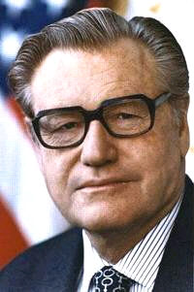
The Election of 1964
The Sixties: 1960-1969 > The Lyndon B. Johnson Administration
Republican candidate Barry Goldwater's far right platform alienated moderate Republicans.
Goldwater succeeded in the Deep South, due to his opposition to the civil rights movement.
African-American voters became increasingly alienated from the Republican party with this election.
Despite his defeat, Goldwater is credited with laying the foundation for the conservative revolution of the coming decades.
Goldwater succeeded in the Deep South, due to his opposition to the civil rights movement.
African-American voters became increasingly alienated from the Republican party with this election.
Despite his defeat, Goldwater is credited with laying the foundation for the conservative revolution of the coming decades.
Nelson Rockefeller, Governor of New York.
View on Boundless.com
Free to share, print, make copies and changes. Get yours at www.boundless.com
www.boundless.com/u-s-history/textbooks/boundless-u-s-history-textbook/the-sixties-1960-1969-29/the-lyndon-b-johnson-administration-223/the-election-of-1964-1249-2517

Slide 7
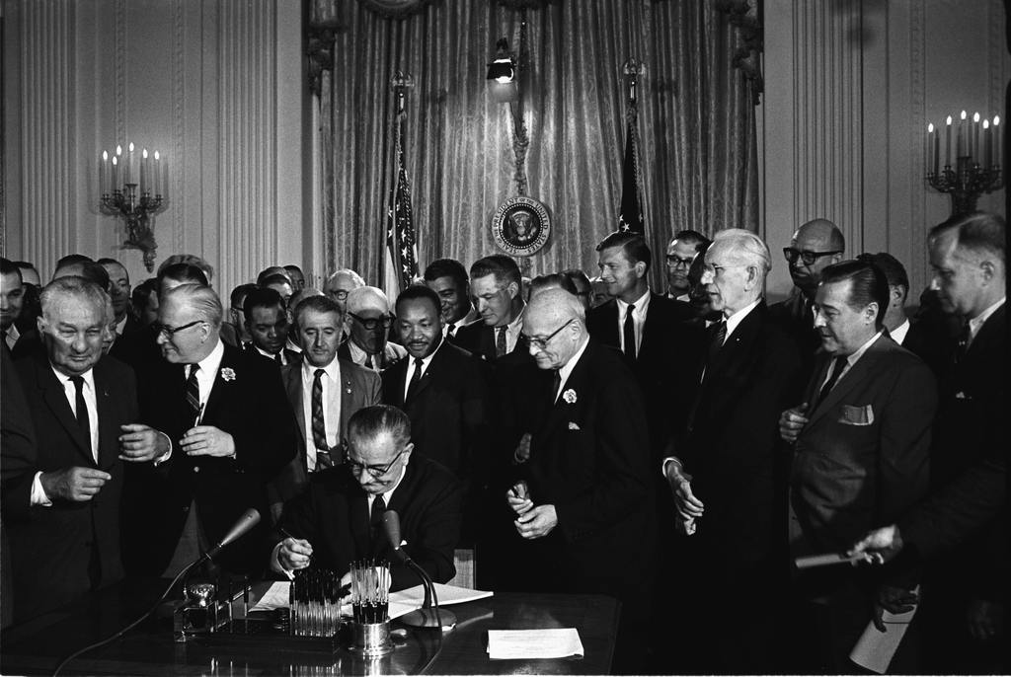
The Civil Rights Act of 1964
The Sixties: 1960-1969 > The Lyndon B. Johnson Administration
Southern members of Congress strongly opposed the bill and launched a filibuster on March 30, 1964 to prevent it.
The filibuster ended in early June after Hubert Humphrey gained enough Republican votes to pass a somewhat modified bill.
Kennedy had fought hard for this legislation; following his assassination the bill was quickly passed, partially as a tribute to Kennedy.
Racial segregation in schools, professional environments, and public spaces was outlawed with the passage of the Civil Rights Act.
This act was soon followed by the Voting Rights Act of 1965 that outlawed discriminatory voting practices.
The Civil Rights Act was passed on June 19, 1964.
Lyndon Johnson Signing the Civil Rights Act, 1964
View on Boundless.com
Free to share, print, make copies and changes. Get yours at www.boundless.com
www.boundless.com/u-s-history/textbooks/boundless-u-s-history-textbook/the-sixties-1960-1969-29/the-lyndon-b-johnson-administration-223/the-civil-rights-act-of-1964-1250-2516

Slide 8
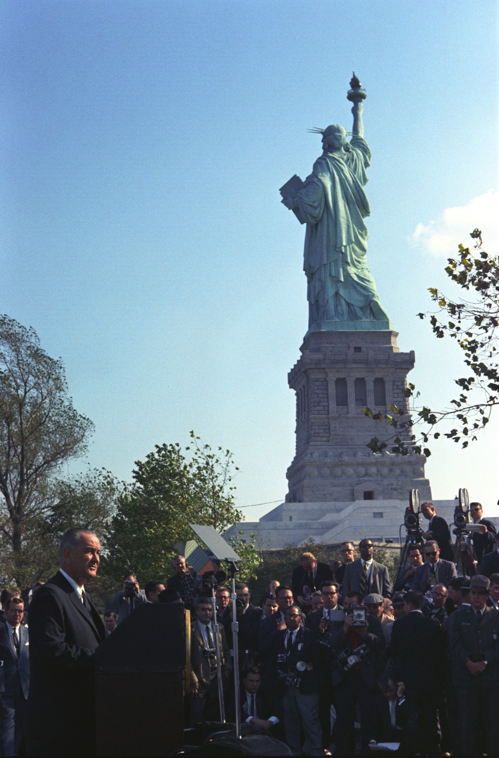
The Immigration Act of 1965
The Sixties: 1960-1969 > The Lyndon B. Johnson Administration
This act removed the immigration quotas established in the National Origins Formula (in place since the 1920s), which privileged Northern and Western European immigrants.
This act was sponsored by New York Representative Emanuel Celler and Michigan Senator Philip Hart.
This bill was unpopular with the American public but received bi-partisan support in Congress.
Passage of this bill resulted in broad demographic changes in the United States as immigration from Latin America, Asia, and Mediterranean Europe increased.
President Johnson signs the Immigration and Nationality Act at the foot of the Statue of Liberty
View on Boundless.com
Free to share, print, make copies and changes. Get yours at www.boundless.com
www.boundless.com/u-s-history/textbooks/boundless-u-s-history-textbook/the-sixties-1960-1969-29/the-lyndon-b-johnson-administration-223/the-immigration-act-of-1965-1251-8799

Slide 9
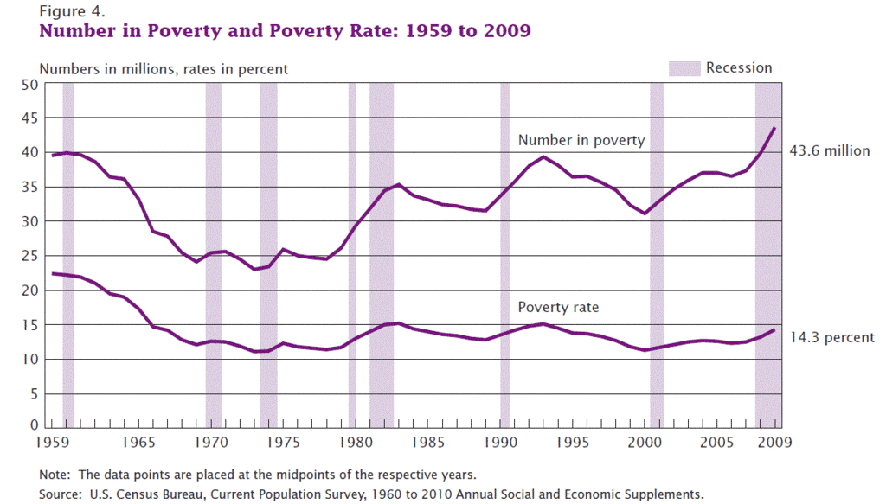
Assessing the Great Society
The Sixties: 1960-1969 > The Lyndon B. Johnson Administration
The success of Johnson's Great Society initiative remains the subject of controversy.
Poverty rates significantly declined during the War on Poverty, hitting an all-time low in 1973.
Poverty in the African-American community was reduced from 55% to 27% in the 1960s.
Critics of the Great Society, including libertarians and conservatives, have labeled the programs instituted by Johnson as "socialist," resulting in a "welfare state".
Many of the programs implemented in the Johnson administration have since been dismantled by conservative leaders.
Number of People in Poverty and Poverty Rate in the United States, 1959-2009
View on Boundless.com
Free to share, print, make copies and changes. Get yours at www.boundless.com
www.boundless.com/u-s-history/textbooks/boundless-u-s-history-textbook/the-sixties-1960-1969-29/the-lyndon-b-johnson-administration-223/assessing-the-great-society-1252-8800

Slide 10
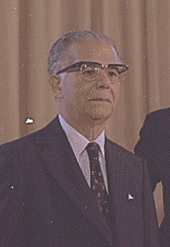
Preventing Another Castro in Latin America
The Sixties: 1960-1969 > The Lyndon B. Johnson Administration
The Johnson administration supported the coup d'état that removed Brazilian President João Goulart from power in April 1964.
The U.S. provided supplies and gave naval support for the coup, orchestrated by generals in the Brazilian military.
In the Dominican Republic, a military coup d'état deposed liberal President Juan Bosch in September 1963, replaced by a civilian junta led by Donald Cabral.
When Cabral's power was threatened by revolution, Johnson ordered U.S. military intervention.
This intervention was implemented with the aid and cooperation of the Organization of American States (OAS).
This intervention was implemented with the aid and cooperation of the Organization of American States (OAS).
Joaquin Balaguer, 1977
View on Boundless.com
Free to share, print, make copies and changes. Get yours at www.boundless.com
www.boundless.com/u-s-history/textbooks/boundless-u-s-history-textbook/the-sixties-1960-1969-29/the-lyndon-b-johnson-administration-223/preventing-another-castro-in-latin-america-1253-2214

Slide 11
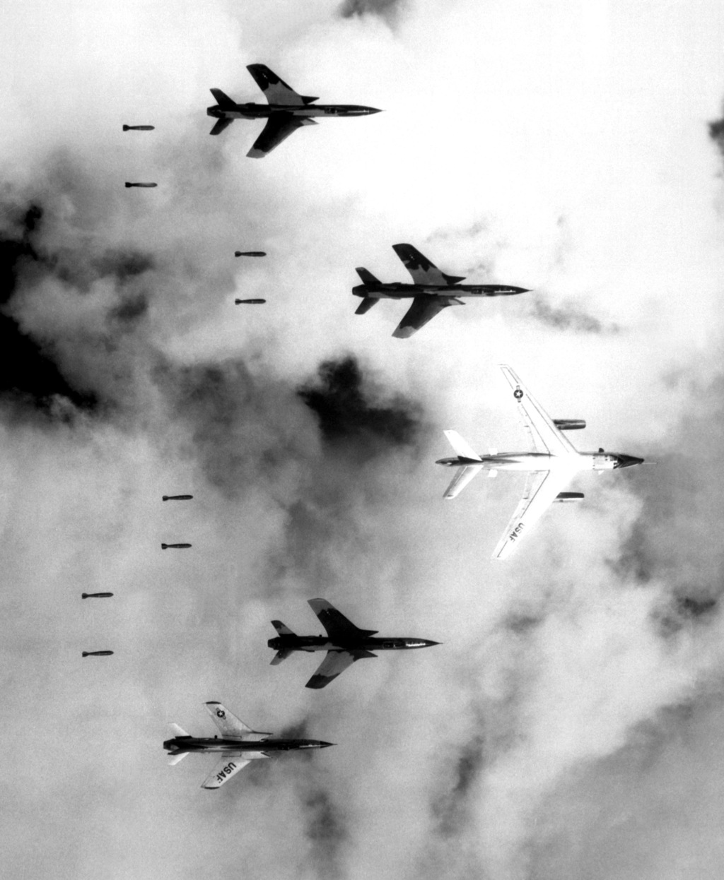
"Americanizing" the Vietnam War
The Sixties: 1960-1969 > The Lyndon B. Johnson Administration
In June 1964, William C. Westmoreland was appointed Commander of U.S. military Operations in the Vietnam War; the American military presence in Vietnam greatly increased under his command.
The U.S. launched Operation Rolling Thunder from 1965 to 1968, a strategic bombing campaign targeting North Vietnam.
In November 1965, the U.S. increased the number of American troops in Vietnam from 120,000 to 400,000.
Bombing Mission in Vietnam, 1966
View on Boundless.com
Free to share, print, make copies and changes. Get yours at www.boundless.com
www.boundless.com/u-s-history/textbooks/boundless-u-s-history-textbook/the-sixties-1960-1969-29/the-lyndon-b-johnson-administration-223/americanizing-the-vietnam-war-1254-8619

Slide 12
The Widening War at Home
The Sixties: 1960-1969 > The Lyndon B. Johnson Administration
Activists and intellectuals seeking a broad range of reforms came to be referred to as the "New Left".
The Weather Underground was a radical faction of this organization.
Protests were led by student activists, particularly the group Students for a Democratic Society (SDS).
In February 1965, Johnson escalated the war in Vietnam, resulting in widespread demonstrations by SDS and other activist groups.
Communism was a controversial issue that divided the anti-war movement.
The government sent spies to infiltrate activist groups and monitor their actions.
View on Boundless.com
Free to share, print, make copies and changes. Get yours at www.boundless.com
www.boundless.com/u-s-history/textbooks/boundless-u-s-history-textbook/the-sixties-1960-1969-29/the-lyndon-b-johnson-administration-223/the-widening-war-at-home-1255-8802

Slide 13
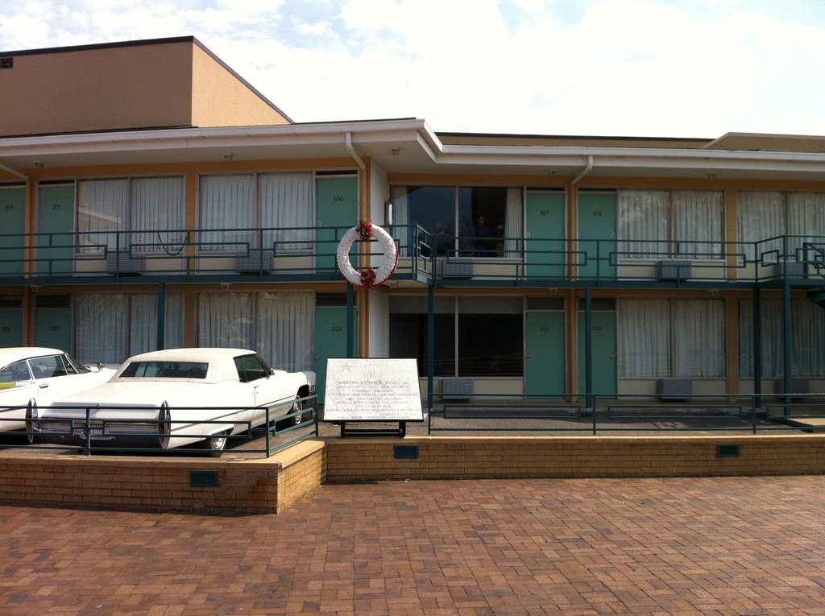
1968: The Year of Upheaval
The Sixties: 1960-1969 > The Lyndon B. Johnson Administration
The Tet Offensive was a surprise military action launched by North Vietnam in January 1968 against South Vietnam and allied U.S. forces.
The Johnson administration's poor handling of this event and lack of honesty in addressing the American public gave momentum to the anti-war movement.
Both Martin Luther King Jr. and Democratic presidential candidate Robert Kennedy were assassinated in the spring of 1968.
Also in the spring of 1968, student activists organized campus protests, rallies, sit-ins, and marches, culminating in the largest student strike in U.S. history on April 26.
The Democratic National Convention was disrupted by anti-war demonstrations.
The Lorraine Motel, cite of MLK's assassination.
View on Boundless.com
Free to share, print, make copies and changes. Get yours at www.boundless.com
www.boundless.com/u-s-history/textbooks/boundless-u-s-history-textbook/the-sixties-1960-1969-29/the-lyndon-b-johnson-administration-223/1968-the-year-of-upheaval-1256-8803

Slide 14
The Election of 1968
The Sixties: 1960-1969 > The Lyndon B. Johnson Administration
President Johnson did not seek reelection due to low approval ratings caused by the unpopularity of the Vietnam War.
Robert Kennedy's assassination in June 1968 and the violent protests outside of the Democratic National Convention disrupted the Democratic Party.
Nixon addressed this issue with a campaign centered around establishing "law and order".
Nixon represented a shift away from the New Deal that had dominated American politics for several decades.
Both candidates addressed the violence, chaos and unrest visible in the riots and demonstrations across the United States.
Nixon addressed this issue with a campaign centered around establishing "law and order".
View on Boundless.com
Free to share, print, make copies and changes. Get yours at www.boundless.com
www.boundless.com/u-s-history/textbooks/boundless-u-s-history-textbook/the-sixties-1960-1969-29/the-lyndon-b-johnson-administration-223/the-election-of-1968-1257-2518

Slide 15
Appendix
Free to share, print, make copies and changes. Get yours at www.boundless.com

Slide 16
Key terms
The Sixties: 1960-1969
Barry Goldwater Barry Morris Goldwater (January 2, 1909 – May 29, 1998) was a businessman and five-term United States Senator from Arizona (1953–1965, 1969–1987) and the Republican Party's nominee for President in the 1964 election.An articulate and charismatic figure during the first half of the 1960s (he was known as "Mr. Conservative").
Civil Rights Act of 1964 Landmark legislation in the United States that outlawed major forms of discrimination against racial, ethnic, national and religious minorities, and women.
Dixiecrats A short-lived segregationist political party in the United States, originating as a breakaway faction of the Democratic Party in 1948, determined to protect what they portrayed as the southern way of life beset by an oppressive federal government.Supporters assumed control of the state Democratic parties in part or in full in several Southern states.The States' Rights Democratic Party opposed racial integration and wanted to retain Jim Crow laws and white supremacy in the face of possible federal intervention.Members were called Dixiecrats, a portmanteau of Dixie, referring to the Southern United States, and Democrat.
Dominican Civil War of 1965 The Dominican Civil War better known as Guerra de Abril took place between April 24, 1965 and September 3, 1965, in Santo Domingo, Dominican Republic.It is known to be the bloodiest armed conflict in the Dominican Republic in the twentieth century.
domino theory The theory that, if South Vietnam fell to Communism, it would be followed by Cambodia, Laos, and additional South Asian countries.
Economic Opportunity Act of 1964 Signed by Lyndon B. Johnson on August 20, 1964, the Economic Opportunity Act of 1964 was central to Johnson's Great Society campaign and its War on Poverty.Implemented by the since-disbanded Office of Economic Opportunity, the Act included several social programs to promote the health, education, and general welfare of the impoverished.
Great Society The Great Society was a set of domestic programs in the United States announced by President Lyndon B. Johnson at Ohio University and subsequently promoted by him and fellow Democrats in Congress in the 1960s.Two main goals of the Great Society social reforms were the elimination of poverty and racial injustice.
Great Society The Great Society was a set of domestic programs in the United States announced by President Lyndon B. Johnson at Ohio University and subsequently promoted by him and fellow Democrats in Congress in the 1960s.Two main goals of the Great Society social reforms were the elimination of poverty and racial injustice.
Gulf of Tonkin The Gulf of Tonkin (Vietnamese: Vịnh Bắc Bộ, simplified Chinese: 北; traditional Chinese: 北; pinyin: Běibù Wān) is a body of water located off northern Vietnam and southern China.It is a northern arm of the South China Sea.
Hubert Humphrey Hubert Horatio Humphrey, Jr. (May 27, 1911 – January 13, 1978), served under President Lyndon B. Johnson as the 38th Vice President of the United States.
immigration the act of passing or coming into a country for the purpose of permanent residence
Immigration and Nationality Act of 1965 A U.S. act that abolished the national origins quota system that had composed American immigration policy since the 1920s, replacing it with a preference system that focused on immigrants' skills and family relationships with citizens or U.S. residents.
Free to share, print, make copies and changes. Get yours at www.boundless.com

Slide 17
The Sixties: 1960-1969
Job Corps Job Corps is a program administered by the United States Department of Labor that offers free-of-charge education and vocational training to youths aged 16 to 24.
Juan Bosch Juan Emilio Bosch Gaviño (June 30, 1909– November 1, 2001, Santo Domingo) was a politician, historian, short story writer, essayist, educator, and the first democratically and legitimately elected president of the Dominican Republic for a brief time in 1963.Previously, he had been the leader of the Dominican opposition in exile to the dictatorial regime of Rafael Trujillo for over 25 years.
junta The ruling council of a military dictatorship.
libertarian Libertarianism refers to the group of political philosophies that emphasize freedom, liberty, and voluntary association.Libertarians generally advocate a society with a government of small scope relative to most present day societies or no government whatsoever.
Lyndon B. Johnson Lyndon Baines Johnson (August 27, 1908 – January 22, 1973), often referred to as LBJ, was the 36th President of the US (1963–1969).After campaigning unsuccessfully for the Democratic nomination in 1960, Johnson was asked by JFK to be his running mate for the 1960 presidential election.Johnson succeeded to the presidency following the assassination of JFK on November 22, 1963.
Martin Luther King Jr Martin Luther King, Jr. (January 15, 1929 – April 4, 1968) was an American clergyman, activist, and prominent leader in the African-American Civil Rights Movement.He is best known for his role in the advancement of civil rights in the United States and around the world, using nonviolent methods following the teachings of Mohandas Karamchand Gandhi.King has become a national icon in the history of modern American liberalism.
National Endowment for the Arts The National Endowment for the Arts (NEA) is an independent agency of the United States federal government that offers support and funding for projects exhibiting artistic excellence.It was created by an act of the U.S. Congress in 1965 as an independent agency of the federal government.
National Origins Formula The National Origins Formula was an American system of immigration quotas, between 1921 and 1965, which restricted immigration on the basis of existing proportions of the population.The goal was to maintain the existing ethnic composition of the United States.It had the effect of giving low quotas to Eastern and Southern Europe.
New Deal The New Deal was a series of economic programs implemented in the United States between 1933 and 1936 during Franklin D. Roosevelt's administration.
New Frontier A phrase used by liberal Democratic presidential candidate John F. Kennedy at the 1960 United States Democratic National Convention as the Democratic slogan to inspire America to support him.The phrase developed into a label for his administration's domestic and foreign programs.
New Left A range of activists, educators, agitators and others in the 1960s and 1970s who focused their attention on marginal identities and, eventually, identity politics.They rejected involvement with the labor movement and Marxism's historical theory of class struggle.Abandoning the Marxist goals of educating the proletariat, the New Left turned to student activism as its reservoir of power.
North Vietnam North Vietnam was a communist state that ruled the northern half of Vietnam from 1954 until 1976.It was officially the Democratic Republic of Vietnam (Vietnamese: Việt Nam Dân chủ Cộng hòa), and was proclaimed in Hanoi in 1945.
Free to share, print, make copies and changes. Get yours at www.boundless.com

Slide 18
The Sixties: 1960-1969
Office of Economic Opportunity The Office of Economic Opportunity was the agency responsible for administering most of the War on Poverty programs created as part of United States President Lyndon B. Johnson's Great Society legislative agenda.
Operation Rolling Thunder Operation Rolling Thunder was the title of a gradual and sustained U.S. 2nd Air Division (later Seventh Air Force), U.S. Navy, and Republic of Vietnam Air Force (VNAF) aerial bombardment campaign conducted against the Democratic Republic of Vietnam (North Vietnam) from 2 March 1965 until 2 November 1968, during the Vietnam War.
Robert F. Kennedy Robert Francis "Bobby" Kennedy (November 20, 1925 – June 6, 1968), also referred to by his initials RFK, was an American politician, a Democratic senator from New York, and a noted civil rights activist.An icon of modern American liberalism and member of the Kennedy family, he was a younger brother of President John F. Kennedy and acted as one of his advisors during his presidency.From 1961 to 1964, he was the U.S. Attorney General.
socialism The intermediate phase of social development between capitalism and full communism.This is a strategy whereby the state has control of all key resource-producing industries and manages most aspects of the economy, in contrast to laissez-faire capitalism.
Students for a Democratic Society Students for a Democratic Society (SDS) was a student activist movement in the United States that was one of the main representations of the country's New Left.The organization developed and expanded rapidly in the mid-1960s before dissolving at its last convention in 1969.SDS has been an important influence on student organizing in the decades since its collapse.
Tet Offensive The Tet Offensive was a military campaign during the Vietnam War that was launched on January 30, 1968 by forces of the People's Army of Vietnam against the forces of the Republic of Vietnam (South Vietnam), the United States, and their allies.The purpose of the offensive was to utilize the element of surprise and strike military and civilian command and control centers throughout South Vietnam, during a period when no attacks were supposed to take place.
Vietnam War The war that occured in Vietnam, Laos, and Cambodia between 1955 and 1975 between South Vietnam (backed by the United States and SEATO) and North Vietnam aiding the South Vietnamese communist guerilla army known as the Vietcong (supported by the People's Republic of China and the Soviet Union) for the struggle for total Communist control of Vietnam as one state.
Voting Rights Act The Voting Rights Act of 1965 (42 U.S.C. § 1973–1973aa-6) is a landmark piece of national legislation in the United States that outlawed discriminatory voting practices that had been responsible for the widespread disenfranchisement of African-Americans in the U.S.
War on Poverty The War on Poverty is the unofficial name for legislation first introduced by United States President Lyndon B. Johnson during his State of the Union address on January 8, 1964.This legislation was proposed by Johnson in response to a national poverty rate of around nineteen percent.
Weather Underground The Weather Underground was an American radical left organization.The Weatherman first organized in 1969 as a faction of Students for a Democratic Society (SDS).They were composed for the most part of the national office leadership of SDS and their supporters.Their goal was to create a clandestine revolutionary party for the violent overthrow of the US government.
welfare state A social system in which the state takes overall responsibility for the welfare of its citizens, providing health care, education, unemployment compensation, and social security.
William C. Westmoreland William Childs Westmoreland (March 26, 1914 – July 18, 2005) was a United States Army General, who commanded U.S. military operations in the Vietnam War at its peak (1964–68), during the Tet Offensive.He adopted a strategy of attrition against the National Liberation Front of South Vietnam and the North Vietnamese Army.
Free to share, print, make copies and changes. Get yours at www.boundless.com

Slide 19
The Sixties: 1960-1969
Robert McNamarra discusses the Gulf of Tonkin Incident
Robert McNamarra recounts the confusion and uncertainty surrounding the Gulf of Tonkin Incident, ultimately reporting that "It didn't happen."
Free to share, print, make copies and changes. Get yours at www.boundless.com
View on Boundless.com

Slide 20
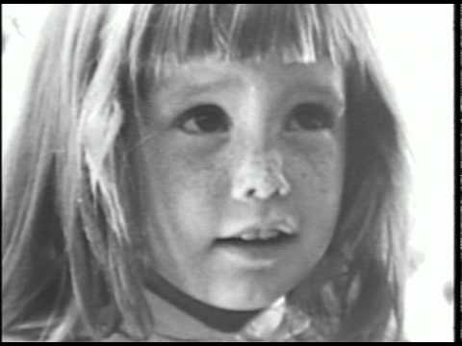
The Sixties: 1960-1969
Daisy TV ad
Although it ran only once, the Daisy Ad evoked fears that Goldwater was an extremist, inclined to nuclear war.It was an early instance at psychologically powerful negative campaigning.
Free to share, print, make copies and changes. Get yours at www.boundless.com
View on Boundless.com

Slide 21
The Sixties: 1960-1969
The Lorraine Motel, cite of MLK's assassination.
MLK's assassination on April 4, 1968 prompted riots in cities around the country and was a blow to Americans who believed in civil rights.
Free to share, print, make copies and changes. Get yours at www.boundless.com
Wikipedia. "Assassination of Martin Luther King, Jr.." GNU FDL http://en.wikipedia.org/wiki/Assassination_of_Martin_Luther_King,_Jr. View on Boundless.com

Slide 22
The Sixties: 1960-1969
Joaquin Balaguer, 1977
After the Coup of 1965, Jaquin Balaguer became president of the Dominican Republic.
Free to share, print, make copies and changes. Get yours at www.boundless.com
Wikipedia. "Joaquin Balaguer 1977." Public domain http://en.wikipedia.org/wiki/File:Joaquin_Balaguer_1977.jpg View on Boundless.com

Slide 23
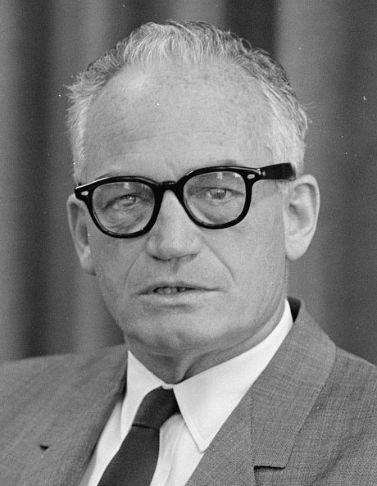
The Sixties: 1960-1969
Barry Goldwater, Senator from Arizona and Republican Candidate for President in 1964.
Goldwater conservative views and penchant for unscripted remarks helped Johnson win in a landslide.However, Goldwater's right-wing conservatism soon became the dominant ideas of the Republican party.
Free to share, print, make copies and changes. Get yours at www.boundless.com
Wikimedia. "Barry Goldwater 2." Public domain http://commons.wikimedia.org/wiki/File:Barry_Goldwater_2.jpg View on Boundless.com

Slide 24
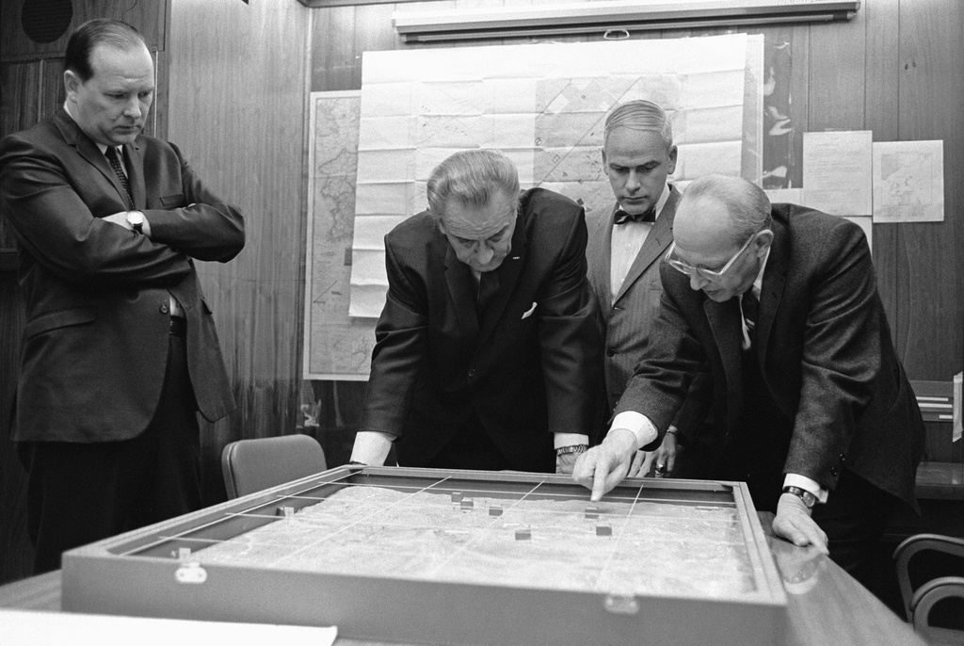
The Sixties: 1960-1969
Walt Rostow shows President Lyndon B. Johnson a model of the Khe Sanh area
President Johnson believed in the "Domino Effect" and escalated America's involvement in Vietnam.
Free to share, print, make copies and changes. Get yours at www.boundless.com
Wikipedia. "Lyndon B. Johnson." Public domain http://en.wikipedia.org/wiki/Lyndon_B._Johnson#Vietnam_War View on Boundless.com

Slide 25
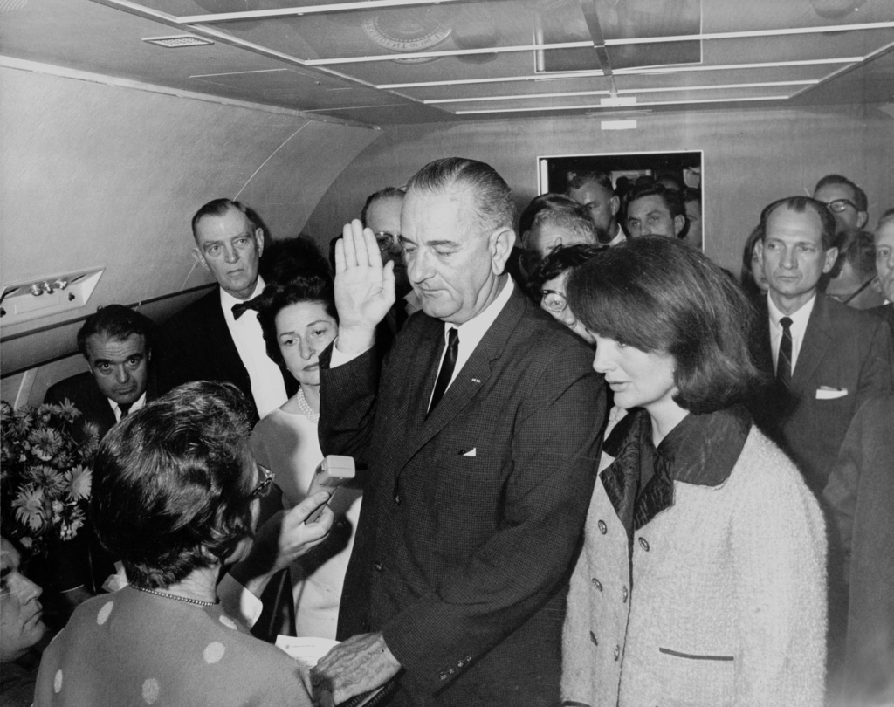
The Sixties: 1960-1969
Lydnon B. Johnson, taking the oath of office aboard Air Force 1.
Johnson became the 36th President of the United States on November 22nd, 1963, following the assassination President Kennedy.Johnson would go on to win election in 1964, accomplishing much of his ambitious domestic agenda.
Free to share, print, make copies and changes. Get yours at www.boundless.com
Wikipedia. "Lyndon B. Johnson." Public domain http://en.wikipedia.org/wiki/Lyndon_B._Johnson View on Boundless.com

Slide 26
The Sixties: 1960-1969
Bombing Mission in Vietnam, 1966
The US launched Operation Rolling Thunder, a strategic bombing campaign of North Vietnam in 1965.
Free to share, print, make copies and changes. Get yours at www.boundless.com
Wikipedia. "Bombing in Vietnam." Public domain http://en.wikipedia.org/wiki/File:Bombing_in_Vietnam.jpg View on Boundless.com

Slide 27
The Sixties: 1960-1969
Lyndon B. Johnson, in the Oval Office.
Former U.S. President Lyndon B. Johnson.
Free to share, print, make copies and changes. Get yours at www.boundless.com
Wikipedia. "Lyndon B. Johnson." Public domain http://en.wikipedia.org/wiki/Lyndon_B._Johnson View on Boundless.com

Slide 28
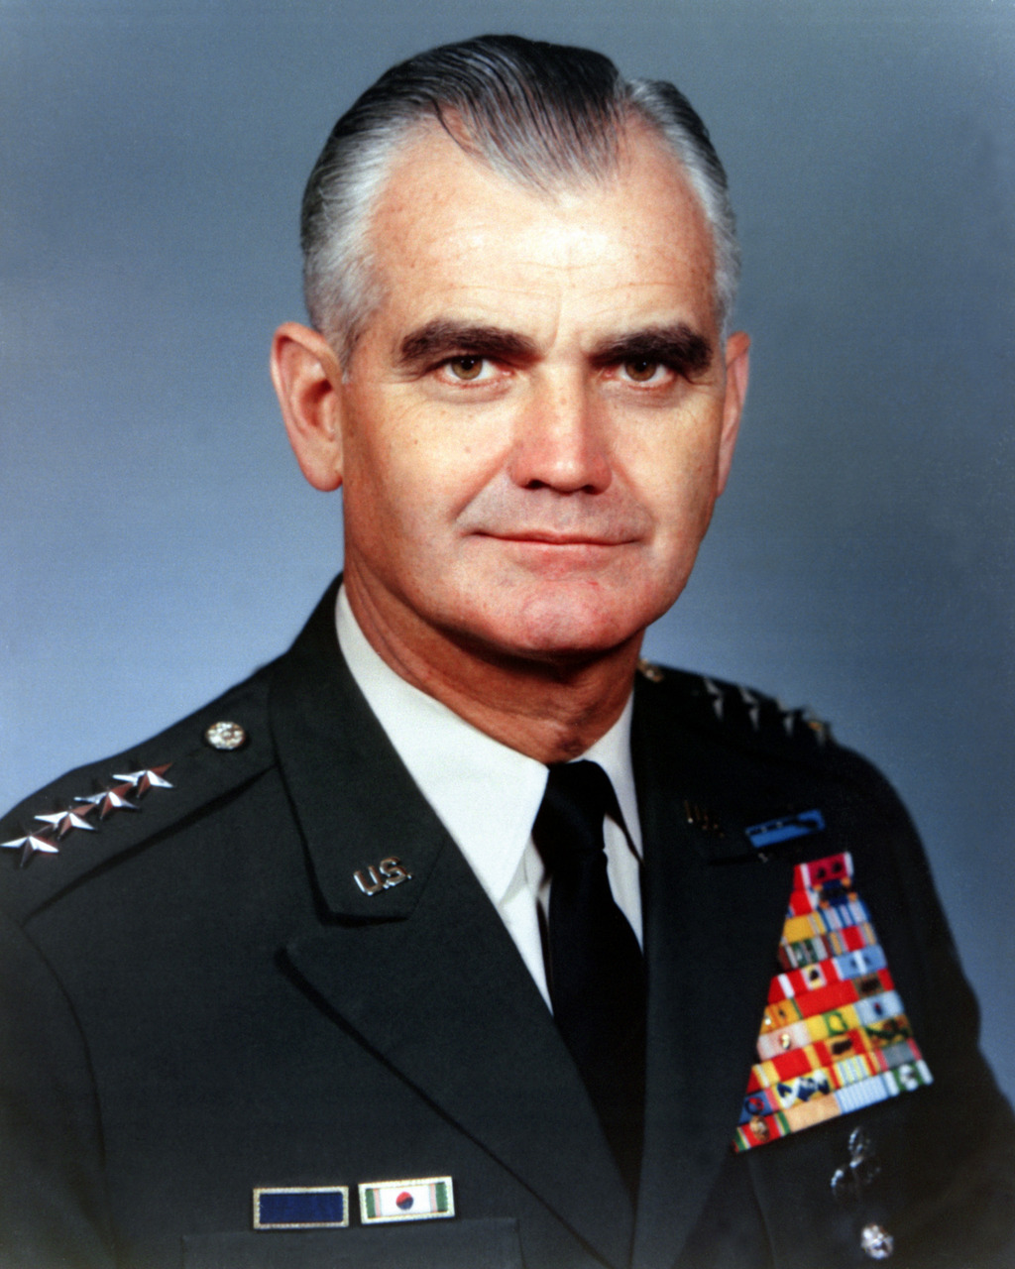
The Sixties: 1960-1969
General William Westmoreland, 1969
General Westmoreland commanded US military operations from 1964 to 1968.He launched a strategy based on attrition and presided over a larges troop increase.
Free to share, print, make copies and changes. Get yours at www.boundless.com
Wikipedia. "William Westmoreland." Public domain http://en.wikipedia.org/wiki/William_Westmoreland View on Boundless.com

Slide 29
The Sixties: 1960-1969
President Johnson signs the Immigration and Nationality Act at the foot of the Statue of Liberty
The Johnson administration supported the reform of the immigration laws, proposed by Democratic congressmen.The act would profoundly alter the nation's demographics.
Free to share, print, make copies and changes. Get yours at www.boundless.com
Wikipedia. "Immigration Act of 1965." Public domain http://en.wikipedia.org/wiki/Immigration_Act_of_1965 View on Boundless.com

Slide 30
The Sixties: 1960-1969
Nelson Rockefeller, Governor of New York.
Nelson Rockefeller was a the leader of the moderate wing of the Republican Party.He was was the front-runner to receive the Republican nomination until his divorce and remarriage alienated social conservatives.
Free to share, print, make copies and changes. Get yours at www.boundless.com
Wikipedia. "1964 Republican National Convention." GNU FDL http://en.wikipedia.org/wiki/1964_Republican_National_Convention View on Boundless.com

Slide 31
The Sixties: 1960-1969
LBJ, at the University of Michigan Commencement Ceremony, 1964
In his commencement address at the University of Michigan, Johnson proclaimed his vision of a "Great Society."
Free to share, print, make copies and changes. Get yours at www.boundless.com
Wikipedia. "Great Society." GNU FDL http://en.wikipedia.org/wiki/Great_Society View on Boundless.com

Slide 32
The Sixties: 1960-1969
Lyndon Johnson Signing the Civil Rights Act, 1964
Lyndon Johnson singing the Civil Rights Act, surrouneded by congressmen and guests, including Dr. Martin Luther King Jr.
Free to share, print, make copies and changes. Get yours at www.boundless.com
Wikipedia. "Civil Rights Act of 1964." Public domain http://en.wikipedia.org/wiki/Civil_Rights_Act_of_1964 View on Boundless.com

Slide 33
The Sixties: 1960-1969
Number of People in Poverty and Poverty Rate in the United States, 1959-2009
Observers debate the impact of the Great Society and War on Poverty on poverty rates and the economy.This graph shows that the poverty rate reached its low point in 1973, the year that the OEO was dismantled.
Free to share, print, make copies and changes. Get yours at www.boundless.com
Wikipedia. "War on Poverty." Public domain http://en.wikipedia.org/wiki/War_on_Poverty#Results_and_aftermath View on Boundless.com

Slide 34
The Sixties: 1960-1969
The presidency of Lyndon Johnson (LBJ) can best be summarized by which of the following statements?
A) Support of LBJ's liberal civil rights and anti-poverty policies increased his popularity after 1965.
B) LBJ declined to capitalize on the Kennedy's death to pass his political agenda.
C) All of these answers.
D) LBJ accomplished an ambitious domestic agenda, but his popularity was sapped by war in Vietnam.
Free to share, print, make copies and changes. Get yours at www.boundless.com

Slide 35
The Sixties: 1960-1969
The presidency of Lyndon Johnson (LBJ) can best be summarized by which of the following statements?
A) Support of LBJ's liberal civil rights and anti-poverty policies increased his popularity after 1965.
B) LBJ declined to capitalize on the Kennedy's death to pass his political agenda.
C) All of these answers.
D) LBJ accomplished an ambitious domestic agenda, but his popularity was sapped by war in Vietnam.
Free to share, print, make copies and changes. Get yours at www.boundless.com
Boundless - LO. "Boundless." CC BY-SA 3.0 http://www.boundless.com/

Slide 36
The Sixties: 1960-1969
Johnson's Great Society program included which of the following?
A) Medicare, providing federal funding for the medical treatment of elderly and disabled Americans.
B) National Endowment for the Arts, National Endowment for the Humanities, and Public Broadcasting.
C) Clear Air, Water Quality, and Clean Water Restoration Acts.
D) All of these answers.
Free to share, print, make copies and changes. Get yours at www.boundless.com

Slide 37
The Sixties: 1960-1969
Johnson's Great Society program included which of the following?
A) Medicare, providing federal funding for the medical treatment of elderly and disabled Americans.
B) National Endowment for the Arts, National Endowment for the Humanities, and Public Broadcasting.
C) Clear Air, Water Quality, and Clean Water Restoration Acts.
D) All of these answers.
Free to share, print, make copies and changes. Get yours at www.boundless.com
Boundless - LO. "Boundless." CC BY-SA 3.0 http://www.boundless.com/

Slide 38
The Sixties: 1960-1969
Johnson's War on Poverty included which of the following initiatives?
A) Project Head Start, which offered preschool education for poor children.
B) All of these answers.
C) The Economic Opportunity Act, creating an office to oversee community-based anti-poverty programs.
D) Volunteers in Service to America (VISTA), a domestic version of the Peace Corps.
Free to share, print, make copies and changes. Get yours at www.boundless.com

Slide 39
The Sixties: 1960-1969
Johnson's War on Poverty included which of the following initiatives?
A) Project Head Start, which offered preschool education for poor children.
B) All of these answers.
C) The Economic Opportunity Act, creating an office to oversee community-based anti-poverty programs.
D) Volunteers in Service to America (VISTA), a domestic version of the Peace Corps.
Free to share, print, make copies and changes. Get yours at www.boundless.com
Boundless - LO. "Boundless." CC BY-SA 3.0 http://www.boundless.com/

Slide 40
The Sixties: 1960-1969
In 1964, the Gulf of Tonkin Resolution authorized which of the following actions?
A) South Vietnam was granted the authority to negotiate with North Vietnamese leader Ho Chi Minh.
B) The CIA was authorized to overthrow Ngo Dinh Diem, the first president of South Vietnam.
C) The USS Turner Joy and USS Maddox were deployed to the Gulf of Tonkin off of North Vietnam.
D) The President was granted full discretion to commit American military forces in Vietnam.
Free to share, print, make copies and changes. Get yours at www.boundless.com

Slide 41
The Sixties: 1960-1969
In 1964, the Gulf of Tonkin Resolution authorized which of the following actions?
A) South Vietnam was granted the authority to negotiate with North Vietnamese leader Ho Chi Minh.
B) The CIA was authorized to overthrow Ngo Dinh Diem, the first president of South Vietnam.
C) The USS Turner Joy and USS Maddox were deployed to the Gulf of Tonkin off of North Vietnam.
D) The President was granted full discretion to commit American military forces in Vietnam.
Free to share, print, make copies and changes. Get yours at www.boundless.com
Boundless - LO. "Boundless." CC BY-SA 3.0 http://www.boundless.com/

Slide 42
The Sixties: 1960-1969
Which of the following statements BEST describes President Lyndon B. Johnson's response to the deteriorating political and military situation in South Vietnam in 1964?
A) Johnson tried hard to avoid committing U.S. troops to South Vietnam but was eventually forced to due to a North Vietnamese attack on U.S. ally Japan.
B) Johnson focused on providing economic aid to South Vietnam in order to prop up the government.
C) Johnson used a supposed North Vietnamese attack on two American destroyers as a pretext to send large numbers of American combat troops to South Vietnam to defend the country from the Communists.
D) Johnson continued sending military advisors to South Vietnam but refused to send large numbers of American combat troops to the region.
Free to share, print, make copies and changes. Get yours at www.boundless.com

Slide 43
The Sixties: 1960-1969
Which of the following statements BEST describes President Lyndon B. Johnson's response to the deteriorating political and military situation in South Vietnam in 1964?
A) Johnson tried hard to avoid committing U.S. troops to South Vietnam but was eventually forced to due to a North Vietnamese attack on U.S. ally Japan.
B) Johnson focused on providing economic aid to South Vietnam in order to prop up the government.
C) Johnson used a supposed North Vietnamese attack on two American destroyers as a pretext to send large numbers of American combat troops to South Vietnam to defend the country from the Communists.
D) Johnson continued sending military advisors to South Vietnam but refused to send large numbers of American combat troops to the region.
Free to share, print, make copies and changes. Get yours at www.boundless.com
Saylor OER. "History « Saylor.org – Free Online Courses Built by Professors." CC BY 3.0 http://www.saylor.org/majors/History/

Slide 44
The Sixties: 1960-1969
The presidential contest of 1964 saw
A) Goldwater appealing to moderate Republicans with his vote against the Civil Rights Act of 1964.
B) Goldwater losing only his native state of Arizona and five Deep South states.
C) the defeat of conservative Goldwater, whose views eventually became central to the Republican party.
D) Johnson distancing himself from the policies of the slain President Kennedy.
Free to share, print, make copies and changes. Get yours at www.boundless.com

Slide 45
The Sixties: 1960-1969
The presidential contest of 1964 saw
A) Goldwater appealing to moderate Republicans with his vote against the Civil Rights Act of 1964.
B) Goldwater losing only his native state of Arizona and five Deep South states.
C) the defeat of conservative Goldwater, whose views eventually became central to the Republican party.
D) Johnson distancing himself from the policies of the slain President Kennedy.
Free to share, print, make copies and changes. Get yours at www.boundless.com
Boundless - LO. "Boundless." CC BY-SA 3.0 http://www.boundless.com/

Slide 46
The Sixties: 1960-1969
The Civil Rights Act of 1964 did which of the following?
A) Passed in the wake of Kennedy's assassination and realized many of his civil rights goals.
B) Overcame a bitter filibuster led by southern Democratic Senators.
C) Asserted Congressional authority to legislate on civil rights under the U.S. Constitution.
D) All of these answers.
Free to share, print, make copies and changes. Get yours at www.boundless.com

Slide 47
The Sixties: 1960-1969
The Civil Rights Act of 1964 did which of the following?
A) Passed in the wake of Kennedy's assassination and realized many of his civil rights goals.
B) Overcame a bitter filibuster led by southern Democratic Senators.
C) Asserted Congressional authority to legislate on civil rights under the U.S. Constitution.
D) All of these answers.
Free to share, print, make copies and changes. Get yours at www.boundless.com
Boundless - LO. "Boundless." CC BY-SA 3.0 http://www.boundless.com/

Slide 48
The Sixties: 1960-1969
What was the significance of the 1965 Voting Rights Act?
A) The law guaranteed that all American citizens would be able to exercise their right to vote and provided federal support for voter registration in the South.
B) The law was the first attempt by Congress to guarantee voting rights for American citizens
C) The law ensured that all Americans would receive equal pay regardless of race or gender.
D) The law marked the culmination of President Lyndon B. Johnson's campaign for the Great Society.
Free to share, print, make copies and changes. Get yours at www.boundless.com

Slide 49
The Sixties: 1960-1969
What was the significance of the 1965 Voting Rights Act?
A) The law guaranteed that all American citizens would be able to exercise their right to vote and provided federal support for voter registration in the South.
B) The law was the first attempt by Congress to guarantee voting rights for American citizens
C) The law ensured that all Americans would receive equal pay regardless of race or gender.
D) The law marked the culmination of President Lyndon B. Johnson's campaign for the Great Society.
Free to share, print, make copies and changes. Get yours at www.boundless.com
Saylor OER. "History « Saylor.org – Free Online Courses Built by Professors." CC BY 3.0 http://www.saylor.org/majors/History/

Slide 50
The Sixties: 1960-1969
The passage of the Immigration and Nationality Act of 1965 resulted in which of the following?
A) By the 1990s, America's population growth was more than one-third driven by legal immigration.
B) The National Origins Formula, which set immigration quotas for specific countries, was abolished.
C) America is expected to have less than 50% whites in the total population by the year 2042.
D) All of these answers.
Free to share, print, make copies and changes. Get yours at www.boundless.com

Slide 51
The Sixties: 1960-1969
The passage of the Immigration and Nationality Act of 1965 resulted in which of the following?
A) By the 1990s, America's population growth was more than one-third driven by legal immigration.
B) The National Origins Formula, which set immigration quotas for specific countries, was abolished.
C) America is expected to have less than 50% whites in the total population by the year 2042.
D) All of these answers.
Free to share, print, make copies and changes. Get yours at www.boundless.com
Boundless - LO. "Boundless." CC BY-SA 3.0 http://www.boundless.com/

Slide 52
The Sixties: 1960-1969
One major criticism of the Great Society and the War on Poverty is
A) the best way to fight poverty is not through government spending but through economic growth.
B) the programs did not do enough to help impoverished African-American families.
C) economic inequality leads to inequality of opportunity, which is contrary to the American ideal.
D) under Johnson, the portion of Americans living below the poverty line dropped from 22.2% to 12.6%.
Free to share, print, make copies and changes. Get yours at www.boundless.com

Slide 53
The Sixties: 1960-1969
One major criticism of the Great Society and the War on Poverty is
A) the best way to fight poverty is not through government spending but through economic growth.
B) the programs did not do enough to help impoverished African-American families.
C) economic inequality leads to inequality of opportunity, which is contrary to the American ideal.
D) under Johnson, the portion of Americans living below the poverty line dropped from 22.2% to 12.6%.
Free to share, print, make copies and changes. Get yours at www.boundless.com
Boundless - LO. "Boundless." CC BY-SA 3.0 http://www.boundless.com/

Slide 54
The Sixties: 1960-1969
U.S. involvement in Latin American during the Johnson Administration can best be understood in the context of
A) anti-communist attitudes of the Cold War and the installation of Castro in Cuba.
B) the Monroe Doctrine, which warned European powers against intervention in the Americas.
C) the Vietnam War, which diverted the attention of the United States Marines Corps.
D) historical trade connections between Brazil and the United States.
Free to share, print, make copies and changes. Get yours at www.boundless.com

Slide 55
The Sixties: 1960-1969
U.S. involvement in Latin American during the Johnson Administration can best be understood in the context of
A) anti-communist attitudes of the Cold War and the installation of Castro in Cuba.
B) the Monroe Doctrine, which warned European powers against intervention in the Americas.
C) the Vietnam War, which diverted the attention of the United States Marines Corps.
D) historical trade connections between Brazil and the United States.
Free to share, print, make copies and changes. Get yours at www.boundless.com
Boundless - LO. "Boundless." CC BY-SA 3.0 http://www.boundless.com/

Slide 56
The Sixties: 1960-1969
The U.S. strategic bombing campaign Rolling Thunder and deployment of 400,000 ground troops successfully served to
A) bolster the morale of the South Vietnamese and to serve as a signaling device to Hanoi.
B) destroy North Vietnam's will to fight, transportation network, and air defenses.
C) cut North Vietnam's logistical supply system in Laos and Cambodia.
D) None of these answers.
Free to share, print, make copies and changes. Get yours at www.boundless.com

Slide 57
The Sixties: 1960-1969
The U.S. strategic bombing campaign Rolling Thunder and deployment of 400,000 ground troops successfully served to
A) bolster the morale of the South Vietnamese and to serve as a signaling device to Hanoi.
B) destroy North Vietnam's will to fight, transportation network, and air defenses.
C) cut North Vietnam's logistical supply system in Laos and Cambodia.
D) None of these answers.
Free to share, print, make copies and changes. Get yours at www.boundless.com
Boundless - LO. "Boundless." CC BY-SA 3.0 http://www.boundless.com/

Slide 58
The Sixties: 1960-1969
Which of the following challenges did U.S. military forces face in South Vietnam?
A) A highly motivated adversary
B) All of the answers
C) Guerilla warfare tactics that made it hard to distinguish friend from foe
D) Restrictive rules of engagement
Free to share, print, make copies and changes. Get yours at www.boundless.com

Slide 59
The Sixties: 1960-1969
Which of the following challenges did U.S. military forces face in South Vietnam?
A) A highly motivated adversary
B) All of the answers
C) Guerilla warfare tactics that made it hard to distinguish friend from foe
D) Restrictive rules of engagement
Free to share, print, make copies and changes. Get yours at www.boundless.com
Saylor OER. "History « Saylor.org – Free Online Courses Built by Professors." CC BY 3.0 http://www.saylor.org/majors/History/

Slide 60
The Sixties: 1960-1969
Students for a Democratic Society (SDS) protested which of the following issues?
A) The Dow Chemical Company's attempts to recruit students for work in war-related industries.
B) The draft of young American men for military service in Vietnam.
C) All of these answers.
D) U.S. military involvement in Vietnam, which some SDS leaders compared to imperalism.
Free to share, print, make copies and changes. Get yours at www.boundless.com

Slide 61
The Sixties: 1960-1969
Students for a Democratic Society (SDS) protested which of the following issues?
A) The Dow Chemical Company's attempts to recruit students for work in war-related industries.
B) The draft of young American men for military service in Vietnam.
C) All of these answers.
D) U.S. military involvement in Vietnam, which some SDS leaders compared to imperalism.
Free to share, print, make copies and changes. Get yours at www.boundless.com
Boundless - LO. "Boundless." CC BY-SA 3.0 http://www.boundless.com/

Slide 62
The Sixties: 1960-1969
The year 1968 was one of serious upheaval in the United States because of which of the following events?
A) 1968 became the deadliest year of the war for the US forces with 16,592 soldiers killed.
B) Leaders Martin Luther King and Robert Kennedy were assassinated within two months of each other.
C) The U.S. Selective Service System made a new draft call for 48,000 men, second highest of the war.
D) All of these answers.
Free to share, print, make copies and changes. Get yours at www.boundless.com

Slide 63
The Sixties: 1960-1969
The year 1968 was one of serious upheaval in the United States because of which of the following events?
A) 1968 became the deadliest year of the war for the US forces with 16,592 soldiers killed.
B) Leaders Martin Luther King and Robert Kennedy were assassinated within two months of each other.
C) The U.S. Selective Service System made a new draft call for 48,000 men, second highest of the war.
D) All of these answers.
Free to share, print, make copies and changes. Get yours at www.boundless.com
Boundless - LO. "Boundless." CC BY-SA 3.0 http://www.boundless.com/

Slide 64
The Sixties: 1960-1969
The 1968 presidential election featured all of the following EXCEPT
A) Lyndon Johnson's defeat by other Democratic factions at the national convention in Chicago.
B) televised violence between activists and police outside of the Democratic convention in Chicago.
C) the deep division of the Democratic party over issues like Vietnam and civil rights.
D) the victory of Nixon, signalling a new Republican dominance in American politics.
Free to share, print, make copies and changes. Get yours at www.boundless.com

Slide 65
The Sixties: 1960-1969
The 1968 presidential election featured all of the following EXCEPT
A) Lyndon Johnson's defeat by other Democratic factions at the national convention in Chicago.
B) televised violence between activists and police outside of the Democratic convention in Chicago.
C) the deep division of the Democratic party over issues like Vietnam and civil rights.
D) the victory of Nixon, signalling a new Republican dominance in American politics.
Free to share, print, make copies and changes. Get yours at www.boundless.com
Boundless - LO. "Boundless." CC BY-SA 3.0 http://www.boundless.com/

Slide 66
Attribution
The Sixties: 1960-1969
Wikipedia. "War on Poverty." CC BY-SA 3.0 http://en.wikipedia.org/wiki/War%20on%20Poverty
Wikipedia. "Great Society." CC BY-SA 3.0 http://en.wikipedia.org/wiki/Great%20Society
Wikipedia. "Lyndon B. Johnson." CC BY-SA 3.0 http://en.wikipedia.org/wiki/Lyndon_B._Johnson
Wikipedia. "Lyndon B. Johnson." CC BY-SA 3.0 http://en.wikipedia.org/wiki/Lyndon_B._Johnson
Wikipedia. "Lyndon B. Johnson Administration." CC BY-SA 3.0 http://en.wikipedia.org/wiki/Lyndon_B._Johnson_Administration#Presidency_1963.E2.80.931969
Wiktionary. "Vietnam War." CC BY-SA 3.0 http://en.wiktionary.org/wiki/Vietnam+War
Wikipedia. "United States occupation of the Dominican Republic (1965–1966)." CC BY-SA 3.0 http://en.wikipedia.org/wiki/United_States_occupation_of_the_Dominican_Republic_(1965%25E2%2580%25931966)
Wikipedia. "Dominican Civil War of 1965." CC BY-SA 3.0 http://en.wikipedia.org/wiki/Dominican%20Civil%20War%20of%201965
Wikipedia. "Juan Bosch." CC BY-SA 3.0 http://en.wikipedia.org/wiki/Juan%20Bosch
Wikipedia. "United States occupation of the Dominican Republic (1965–1966)." CC BY-SA 3.0 http://en.wikipedia.org/wiki/United_States_occupation_of_the_Dominican_Republic_(1965%25E2%2580%25931966)
Wikipedia. "1964 Brazilian coup d'état." CC BY-SA 3.0 http://en.wikipedia.org/wiki/1964_Brazilian_coup_d%2527%25C3%25A9tat
Wikipedia. "1964 Brazilian coup d'état." CC BY-SA 3.0 http://en.wikipedia.org/wiki/1964_Brazilian_coup_d%2527%25C3%25A9tat
Wikipedia. "United States occupation of the Dominican Republic (1965–1966)." CC BY-SA 3.0 http://en.wikipedia.org/wiki/United_States_occupation_of_the_Dominican_Republic_(1965%25E2%2580%25931966)
Wikipedia. "United States occupation of the Dominican Republic (1965–1966)." CC BY-SA 3.0 http://en.wikipedia.org/wiki/United_States_occupation_of_the_Dominican_Republic_(1965%25E2%2580%25931966)
Wiktionary. "junta." CC BY-SA 3.0 http://en.wiktionary.org/wiki/junta
Wikipedia. "Gulf of Tonkin incident." CC BY-SA 3.0 http://en.wikipedia.org/wiki/Gulf_of_Tonkin_incident
Wikipedia. "Gulf of Tonkin." CC BY-SA 3.0 http://en.wikipedia.org/wiki/Gulf%20of%20Tonkin
Free to share, print, make copies and changes. Get yours at www.boundless.com

Slide 67
The Sixties: 1960-1969
Wikipedia. "North Vietnam." CC BY-SA 3.0 http://en.wikipedia.org/wiki/North%20Vietnam
Wikipedia. "Vietnam War." CC BY-SA 3.0 http://en.wikipedia.org/wiki/Vietnam_War#Lyndon_B._Johnson_escalates_the_war.2C_1963.E2.80.931969
Wikipedia. "Vietnam War." CC BY-SA 3.0 http://en.wikipedia.org/wiki/Vietnam_War#Lyndon_B._Johnson_escalates_the_war.2C_1963.E2.80.931969
Wikipedia. "Joint warfare in South Vietnam 1963–1969." CC BY-SA 3.0 http://en.wikipedia.org/wiki/Joint_warfare_in_South_Vietnam_1963%25E2%2580%25931969
Wikipedia. "Vietnam War." CC BY-SA 3.0 http://en.wikipedia.org/wiki/Vietnam_War#Lyndon_B._Johnson_escalates_the_war.2C_1963.E2.80.931969
Wiktionary. "domino theory." CC BY-SA 3.0 http://en.wiktionary.org/wiki/domino+theory
Wikipedia. "National Endowment for the Arts." CC BY-SA 3.0 http://en.wikipedia.org/wiki/National%20Endowment%20for%20the%20Arts
Wikipedia. "New Frontier." CC BY-SA 3.0 http://en.wikipedia.org/wiki/New%20Frontier
Wikipedia. "New Deal." CC BY-SA 3.0 http://en.wikipedia.org/wiki/New%20Deal
Wikipedia. "Great Society." CC BY-SA 3.0 http://en.wikipedia.org/wiki/Great_Society#The_Legacies_of_the_Great_Society
Wikipedia. "Great Society." CC BY-SA 3.0 http://en.wikipedia.org/wiki/Great_Society#Major_programs
Wikipedia. "Great Society." CC BY-SA 3.0 http://en.wikipedia.org/wiki/Great_Society#1965_legislative_program_and_presidential_task_forces
Wikipedia. "Great Society." CC BY-SA 3.0 http://en.wikipedia.org/wiki/Great_Society#Economic_and_social_conditions
Wikipedia. "Great Society." CC BY-SA 3.0 http://en.wikipedia.org/wiki/Great_Society
Wikipedia. "Great Society." CC BY-SA 3.0 http://en.wikipedia.org/wiki/Great_Society#Civil_rights
Wikipedia. "Voting Rights Act." CC BY-SA 3.0 http://en.wikipedia.org/wiki/Voting%20Rights%20Act
Wikipedia. "Hubert Humphrey." CC BY-SA 3.0 http://en.wikipedia.org/wiki/Hubert%20Humphrey
Wikipedia. "Great Society." CC BY-SA 3.0 http://en.wikipedia.org/wiki/Great%20Society
Wikipedia. "Civil Rights Act of 1964." CC BY-SA 3.0 http://en.wikipedia.org/wiki/Civil%20Rights%20Act%20of%201964
Free to share, print, make copies and changes. Get yours at www.boundless.com

Slide 68
The Sixties: 1960-1969
Wikipedia. "Civil Rights Act of 1964." CC BY-SA 3.0 http://en.wikipedia.org/wiki/Civil_Rights_Act_of_1964
Wikipedia. "Civil Rights Act of 1964." CC BY-SA 3.0 http://en.wikipedia.org/wiki/Civil_Rights_Act_of_1964
Wikipedia. "Civil Rights Act of 1964." CC BY-SA 3.0 http://en.wikipedia.org/wiki/Civil_Rights_Act_of_1964
Wikipedia. "Civil Rights Act of 1964." CC BY-SA 3.0 http://en.wikipedia.org/wiki/Civil_Rights_Act_of_1964
Wikipedia. "Civil Rights Act of 1964." CC BY-SA 3.0 http://en.wikipedia.org/wiki/Civil_Rights_Act_of_1964
Wikipedia. "Lyndon B. Johnson." CC BY-SA 3.0 http://en.wikipedia.org/wiki/Lyndon%20B.%20Johnson
Wikipedia. "Barry Goldwater." CC BY-SA 3.0 http://en.wikipedia.org/wiki/Barry%20Goldwater
Wikipedia. "United States presidential election, 1964." CC BY-SA 3.0 http://en.wikipedia.org/wiki/United_States_presidential_election,_1964
Wikipedia. "United States presidential election, 1964." CC BY-SA 3.0 http://en.wikipedia.org/wiki/United_States_presidential_election,_1964
Wikipedia. "United States presidential election, 1964." CC BY-SA 3.0 http://en.wikipedia.org/wiki/United_States_presidential_election,_1964
Wikipedia. "United States presidential election, 1964." CC BY-SA 3.0 http://en.wikipedia.org/wiki/United_States_presidential_election,_1964
Wikipedia. "United States presidential election, 1964." CC BY-SA 3.0 http://en.wikipedia.org/wiki/United_States_presidential_election,_1964
Wikipedia. "United States presidential election, 1968." CC BY-SA 3.0 http://en.wikipedia.org/wiki/United_States_presidential_election,_1968
Wikipedia. "United States presidential election, 1968." CC BY-SA 3.0 http://en.wikipedia.org/wiki/United_States_presidential_election,_1968
Wikipedia. "United States presidential election, 1968." CC BY-SA 3.0 http://en.wikipedia.org/wiki/United_States_presidential_election,_1968
Wikipedia. "United States presidential election, 1968." CC BY-SA 3.0 http://en.wikipedia.org/wiki/United_States_presidential_election,_1968
Wikipedia. "United States presidential election, 1968." CC BY-SA 3.0 http://en.wikipedia.org/wiki/United_States_presidential_election,_1968
Wikipedia. "United States presidential election, 1968." CC BY-SA 3.0 http://en.wikipedia.org/wiki/United_States_presidential_election,_1968
Wikipedia. "United States presidential election, 1968." CC BY-SA 3.0 http://en.wikipedia.org/wiki/United_States_presidential_election,_1968
Free to share, print, make copies and changes. Get yours at www.boundless.com

Slide 69
The Sixties: 1960-1969
Wikipedia. "United States presidential election, 1968." CC BY-SA 3.0 http://en.wikipedia.org/wiki/United_States_presidential_election,_1968
Wikipedia. "United States presidential election, 1968." CC BY-SA 3.0 http://en.wikipedia.org/wiki/United_States_presidential_election,_1968
Wikipedia. "Dixiecrats." CC BY-SA 3.0 http://en.wikipedia.org/wiki/Dixiecrats
Wikipedia. "Vietnam War." CC BY-SA 3.0 http://en.wikipedia.org/wiki/Vietnam_War
Wikipedia. "Vietnam War." CC BY-SA 3.0 http://en.wikipedia.org/wiki/Vietnam_War
Wikipedia. "Operation Rolling Thunder." CC BY-SA 3.0 http://en.wikipedia.org/wiki/Operation%20Rolling%20Thunder
Wikipedia. "William C. Westmoreland." CC BY-SA 3.0 http://en.wikipedia.org/wiki/William%20C.%20Westmoreland
Wikipedia. "Role of the United States in the Vietnam War." CC BY-SA 3.0 http://en.wikipedia.org/wiki/Role_of_the_United_States_in_the_Vietnam_War#Americanization
Wikipedia. "Role of the United States in the Vietnam War." CC BY-SA 3.0 http://en.wikipedia.org/wiki/Role_of_the_United_States_in_the_Vietnam_War#Americanization
Wikipedia. "Role of the United States in the Vietnam War." CC BY-SA 3.0 http://en.wikipedia.org/wiki/Role_of_the_United_States_in_the_Vietnam_War#Americanization
Wikipedia. "Role of the United States in the Vietnam War." CC BY-SA 3.0 http://en.wikipedia.org/wiki/Role_of_the_United_States_in_the_Vietnam_War#Americanization
Wiktionary. "immigration." CC BY-SA 3.0 http://en.wiktionary.org/wiki/immigration
Wikipedia. "Immigration and Nationality Act of 1965." CC BY-SA 3.0 http://en.wikipedia.org/wiki/Immigration%20and%20Nationality%20Act%20of%201965
Wikipedia. "National Origins Formula." CC BY-SA 3.0 http://en.wikipedia.org/wiki/National%20Origins%20Formula
Wikipedia. "Immigration Act of 1965." CC BY-SA 3.0 http://en.wikipedia.org/wiki/Immigration_Act_of_1965
Wikipedia. "Immigration Act of 1965." CC BY-SA 3.0 http://en.wikipedia.org/wiki/Immigration_Act_of_1965
Wikipedia. "Immigration Act of 1965." CC BY-SA 3.0 http://en.wikipedia.org/wiki/Immigration_Act_of_1965
Wiktionary. "libertarian." CC BY-SA 3.0 http://en.wiktionary.org/wiki/libertarian
Wiktionary. "socialism." CC BY-SA 3.0 http://en.wiktionary.org/wiki/socialism
Free to share, print, make copies and changes. Get yours at www.boundless.com

Slide 70
The Sixties: 1960-1969
Wiktionary. "welfare state." CC BY-SA 3.0 http://en.wiktionary.org/wiki/welfare+state
Wikipedia. "War on Poverty." CC BY-SA 3.0 http://en.wikipedia.org/wiki/War_on_Poverty#Criticisms
Wikipedia. "Great Society." CC BY-SA 3.0 http://en.wikipedia.org/wiki/Great_Society#The_Legacies_of_the_Great_Society
Wikipedia. "Job Corps." CC BY-SA 3.0 http://en.wikipedia.org/wiki/Job%20Corps
Wikipedia. "Economic Opportunity Act of 1964." CC BY-SA 3.0 http://en.wikipedia.org/wiki/Economic%20Opportunity%20Act%20of%201964
Wikipedia. "Office of Economic Opportunity." CC BY-SA 3.0 http://en.wikipedia.org/wiki/Office%20of%20Economic%20Opportunity
Wikipedia. "War on Poverty." CC BY-SA 3.0 http://en.wikipedia.org/wiki/War_on_Poverty#Results_and_aftermath
Wikipedia. "War on Poverty." CC BY-SA 3.0 http://en.wikipedia.org/wiki/War_on_Poverty
Wikipedia. "Great Society." CC BY-SA 3.0 http://en.wikipedia.org/wiki/Great_Society#War_on_Poverty
Wikipedia. "New Left." CC BY-SA 3.0 http://en.wikipedia.org/wiki/New%20Left
Wikipedia. "Weather Underground." CC BY-SA 3.0 http://en.wikipedia.org/wiki/Weather%20Underground
Wikipedia. "Students for a Democratic Society." CC BY-SA 3.0 http://en.wikipedia.org/wiki/Students%20for%20a%20Democratic%20Society
Wikipedia. "Vietnam War." CC BY-SA 3.0 http://en.wikipedia.org/wiki/Vietnam_War#Opposition_to_the_Vietnam_War:_1962.E2.80.931975
Wikipedia. "Students for a Democratic Society." CC BY-SA 3.0 http://en.wikipedia.org/wiki/Students_for_a_Democratic_Society#From_protest_to_resistance:_1965.E2.80.931968
Wikipedia. "Opposition to the U.S. involvement in the Vietnam War." CC BY-SA 3.0 http://en.wikipedia.org/wiki/Opposition_to_the_U.S._involvement_in_the_Vietnam_War
Wikipedia. "Students for a Democratic Society." CC BY-SA 3.0 http://en.wikipedia.org/wiki/Students_for_a_Democratic_Society#From_protest_to_resistance:_1965.E2.80.931968
Wikipedia. "Martin Luther King Jr." CC BY-SA 3.0 http://en.wikipedia.org/wiki/Martin%20Luther%20King%20Jr
Wikipedia. "Robert F. Kennedy." CC BY-SA 3.0 http://en.wikipedia.org/wiki/Robert%20F.%20Kennedy
Wikipedia. "Tet Offensive." CC BY-SA 3.0 http://en.wikipedia.org/wiki/Tet%20Offensive
Free to share, print, make copies and changes. Get yours at www.boundless.com

Slide 71
The Sixties: 1960-1969
Wikipedia. "1968 Democratic National Convention." CC BY-SA 3.0 http://en.wikipedia.org/wiki/1968_Democratic_National_Convention
Wikipedia. "Tet Offensive." CC BY-SA 3.0 http://en.wikipedia.org/wiki/Tet_Offensive#Aftermath
Wikipedia. "Assassination of Martin Luther King, Jr.." CC BY-SA 3.0 http://en.wikipedia.org/wiki/Assassination_of_Martin_Luther_King,_Jr.
Free to share, print, make copies and changes. Get yours at www.boundless.com

