Slide 1
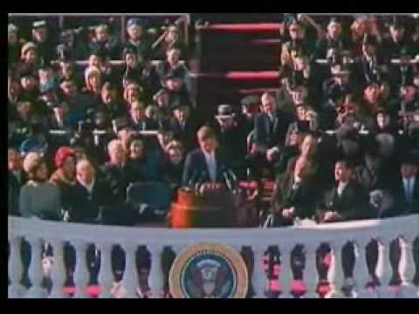
The John F. Kennedy Administration
The Sixties: 1960-1969 > The John F. Kennedy Administration
The John F. Kennedy Administration
"The Hour of Maximum Danger"
New Approaches to the Third World
The Warren Court
The Cuban Missile Crisis
A Growing War in Vietnam
Kennedy's Assassination
Free to share, print, make copies and changes. Get yours at www.boundless.com
www.boundless.com/u-s-history

Slide 2
The John F. Kennedy Administration
The Sixties: 1960-1969 > The John F. Kennedy Administration
In his inaugural address, John F. Kennedy called for an active citizenry and the desire for greater internationalism.
Kennedy's management style differed from his predecessor, Dwight Eisenhower, favoring an organizational structure of a wheel with all spokes leading to the president.
As part of his desire for an active citizenry and greater internationalism, Kennedy asked Congress to create the Peace Corps that brought American volunteers to underdeveloped nations.
Sources of immigration shifted under the Kennedy administration, from European countries toward Latin America and Asia, under the Immigration and Nationality Act of 1965 (passed after his death).
Kennedy was a supporter of African American civil rights, and also supported the rights of marginalized groups such as women as outlined in his Presidential Commission on the Status of Women.
The U.S. space program and the development of NASA was a priority for Kennedy, who saw justification in the expense for reasons of international prestige and military value.
"Ask Not What Your Country Can Do For You"
View on Boundless.com
Free to share, print, make copies and changes. Get yours at www.boundless.com
www.boundless.com/u-s-history/textbooks/boundless-u-s-history-textbook/the-sixties-1960-1969-29/the-john-f-kennedy-administration-222/the-john-f-kennedy-administration-1238-9767

Slide 3
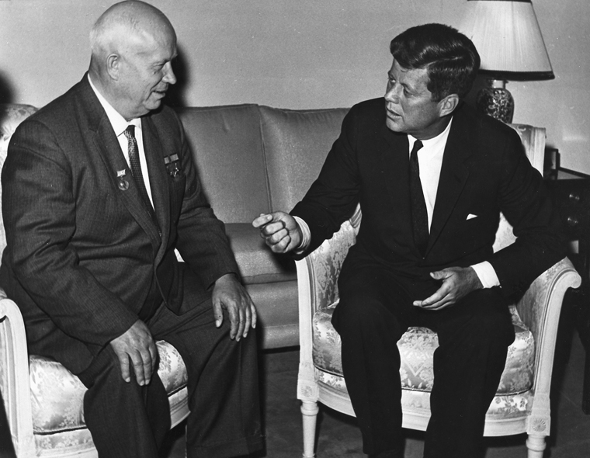
"The Hour of Maximum Danger"
The Sixties: 1960-1969 > The John F. Kennedy Administration
U.S. foreign policy toward the Soviet Union under the Kennedy administration favored containment: limiting the spread of communism in countries around the world.
In 1961, following a proposed treaty between the Soviet Union and East Berlin, Kennedy issued a warning to Nikita Khrushchev not to block access between East and West Berlin.Khrushchev ignored these warnings and blocked the flow of Berliners by erecting the Berlin Wall.
Known as the Bay of Pigs Invasion, Kennedy ordered the invasion of U.S.-trained Cubans to overthrow the communist government run by Fidel Castro, which ended disastrously for the U.S.
Recognizing mutual interest in limiting radioactive contamination and nuclear weapons proliferation, the U.S. and Soviet Union reached a nuclear test ban treaty in 1961.
Vienna Summit
View on Boundless.com
Free to share, print, make copies and changes. Get yours at www.boundless.com
www.boundless.com/u-s-history/textbooks/boundless-u-s-history-textbook/the-sixties-1960-1969-29/the-john-f-kennedy-administration-222/the-hour-of-maximum-danger-1239-8797

Slide 4
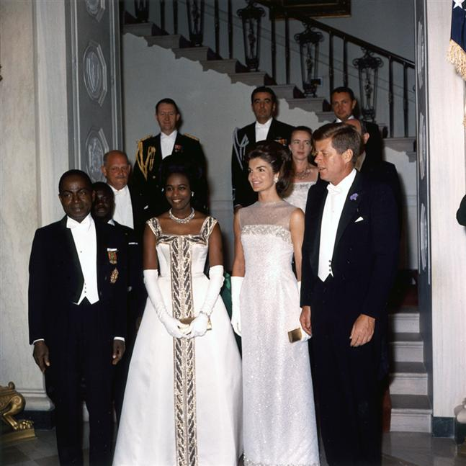
New Approaches to the Third World
The Sixties: 1960-1969 > The John F. Kennedy Administration
Although Kennedy focused his containment strategy on Latin America, diplomatic and military initiatives occurred around the world.
Kennedy's foreign policy toward the Middle East focused on limiting the proliferation of nuclear weapons in Israel and a willingness to work with Egypt's Gamal Abdel Nasser and his Pan-Arab initiatives.
Kennedy's policies toward Africa focused on tacit support for African nationalism, and coordination with the United Nations, to ensure U.S. assistance in financing U.N. peacekeeping operation on the continent.
JFK and Africa
View on Boundless.com
Free to share, print, make copies and changes. Get yours at www.boundless.com
www.boundless.com/u-s-history/textbooks/boundless-u-s-history-textbook/the-sixties-1960-1969-29/the-john-f-kennedy-administration-222/new-approaches-to-the-third-world-1240-8617

Slide 5
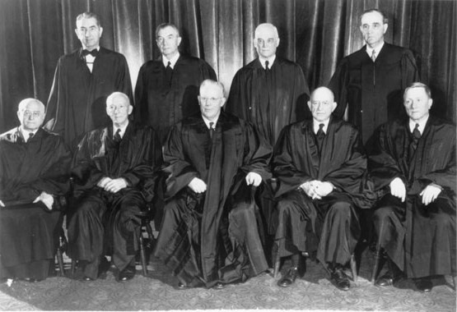
The Warren Court
The Sixties: 1960-1969 > The John F. Kennedy Administration
The Warren Court was characterized by a high level of consensus, an unwillingness to allow constitutional rights to vary from state to state, and attention to ethical principles over narrow interpretive structures or strict precedent.
Under the Warren Court, civil rights, civil liberties, judicial power, and federal power were all expanded.
One of the most famous cases presided by the Warren Court was Brown v. Board of Education, the landmark case that ruled the segregation of public schools as unconstitutional.
the over-representation of rural areas in state legislatures and the under-representation of suburbs, known as one man, one vote cases, was ended under the Warren Court, with states reapportioning their legislatures.
The case Miranda v. Arizona, required that certain rights of a person interrogated while in police custody be clearly explained, including the right to an attorney (often called the "Miranda warning").
1953 Supreme Court
View on Boundless.com
Free to share, print, make copies and changes. Get yours at www.boundless.com
www.boundless.com/u-s-history/textbooks/boundless-u-s-history-textbook/the-sixties-1960-1969-29/the-john-f-kennedy-administration-222/the-warren-court-1241-8616

Slide 6
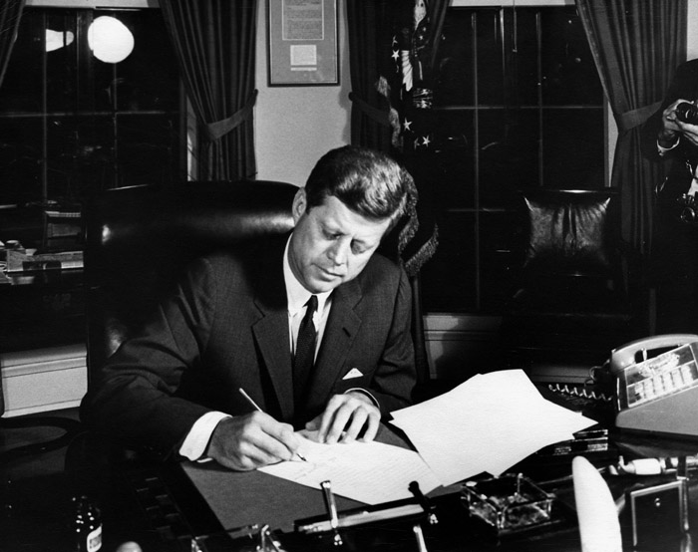
The Cuban Missile Crisis
The Sixties: 1960-1969 > The John F. Kennedy Administration
The crisis is regarded as the closest the U.S. and Soviet Union came to nuclear exchange during the Cold War, with the U.S. favoring a military blockade of Cuba over an attack via air and sea.
Although the Soviets publicly accepted U.S. demands to remove missile bases from Cuba, secret back-channel communications between Kennedy and Khrushchev negotiated the dismantling of U.S.-built missiles deployed in Turkey and Italy.
As a result of the negotiations and overall danger of the crisis, the two countries created the Hotline Agreement and the Moscow-Washington hotline, which established direct communications between the capitals.
An additional outcome of this Kennedy-Khrushchev Pact that ended the Cuban Missile Crisis was that it effectively strengthened Castro's position by guaranteeing that the US would not invade Cuba.
Containment of Cuba
View on Boundless.com
Free to share, print, make copies and changes. Get yours at www.boundless.com
www.boundless.com/u-s-history/textbooks/boundless-u-s-history-textbook/the-sixties-1960-1969-29/the-john-f-kennedy-administration-222/the-cuban-missile-crisis-1242-9768

Slide 7
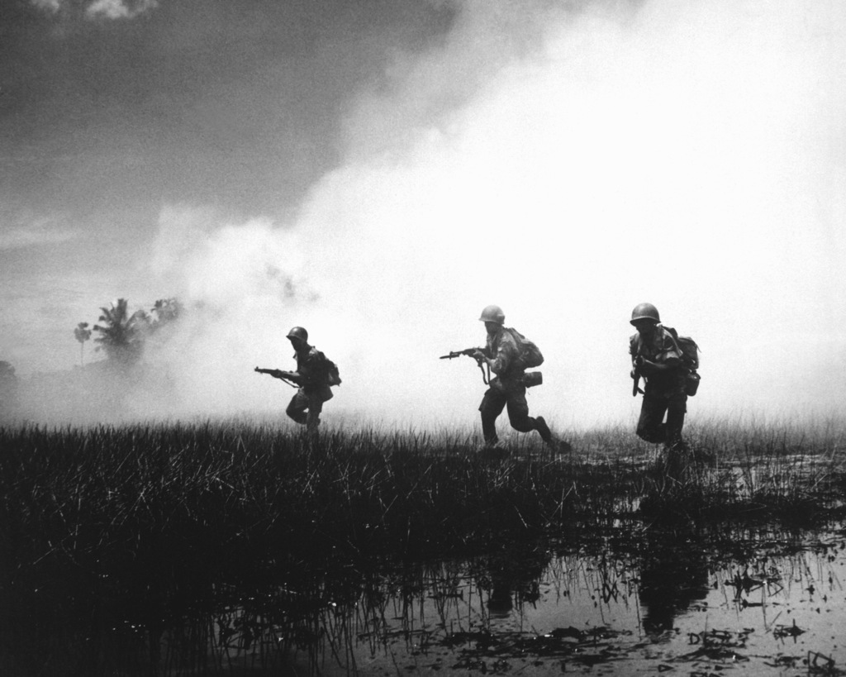
A Growing War in Vietnam
The Sixties: 1960-1969 > The John F. Kennedy Administration
The failure of the Bay of Pigs Invasion, the construction of the Berlin Wall, and the spread of communism to Laos prompted Kennedy to expand his containment policy and strengthen U.S. credibility in limiting the spread of communism.
Following the declaration of Laos as neutral, Kennedy focused on Vietnam to repair U.S. credibility and began aiding the South Vietnamese and their president Ngo Dinh Diem.
Kennedy increased U.S. involvement in Vietnam between 1961 and 1963, funding the enlargement of the South Vietnamese army under the Military Assistance Command Vietnam and Foreign Assistance Act of 1962.
In 1963, in contact with the U.S. Central Intelligence Agency, South Vietnamese generals overthrew and executed President Diem, causing major instability in the south and subsequent gains by the Viet Cong and communist insurgents.
South Vietnamese Troops
View on Boundless.com
Free to share, print, make copies and changes. Get yours at www.boundless.com
www.boundless.com/u-s-history/textbooks/boundless-u-s-history-textbook/the-sixties-1960-1969-29/the-john-f-kennedy-administration-222/a-growing-war-in-vietnam-1243-9281

Slide 8
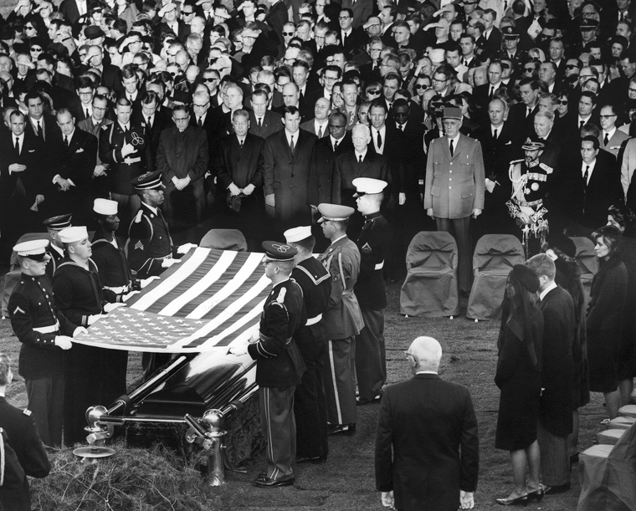
Kennedy's Assassination
The Sixties: 1960-1969 > The John F. Kennedy Administration
Within hours following the assassination, Lee Harvey Oswald was arrested for the murder by Dallas police and charged later that night.
The murder trial of Oswald never occurred, as he was shot and killed by Dallas nightclub owner Jack Ruby while being transferred to the Dallas County Jail.
The Warren Commission, created by Lyndon Johnson, who succeeded Kennedy as president, investigated the assassination and concluded that Oswald and Ruby had both acted alone in their separate murders.
The United States House Select Committee on Assassinations concluded in 1979 that the Kennedy assassination was most likely the result of a conspiracy, finding the Warren Commission and original FBI investigation to be flawed.
JFK's Funeral
View on Boundless.com
Free to share, print, make copies and changes. Get yours at www.boundless.com
www.boundless.com/u-s-history/textbooks/boundless-u-s-history-textbook/the-sixties-1960-1969-29/the-john-f-kennedy-administration-222/kennedy-s-assassination-1244-9280

Slide 9
Appendix
Free to share, print, make copies and changes. Get yours at www.boundless.com

Slide 10
Key terms
The Sixties: 1960-1969
African Nationalism The nationalist political movement for the acknowledgment of African tribes by instituting their own states, as well as the safeguarding of their indigenous customs.
Alliance for Progress A plan and program initiated by U.S. President John F. Kennedy in 1961 which aimed to establish economic cooperation between the U.S. and Latin America.
Bay of Pigs Invasion An unsuccessful action by a CIA-trained force of Cuban exiles in 1961 to invade southern Cuba, with support and encouragement from the U.S. government, in an attempt to overthrow the Cuban government of Fidel Castro.
Berlin Crisis of 1961 The Berlin Crisis of 1961 (June 4–November 9, 1961) was the last major politico-military European incident of the Cold War.The U.S.S.R. provoked the Berlin Crisis with an ultimatum demanding the withdrawal of Western armed forces from West Berlin—culminating with the city's de facto partition with the East German erection of the Berlin Wall.
blockade By extension, any form of formal isolation of something, especially with the force of law or arms.
Brown v. Board of Education (1954) A landmark United States Supreme Court case in which the Court declared state laws establishing separate public schools for black and white students unconstitutional.
containment A United States policy using numerous strategies to prevent the spread of communism abroad.A component of the Cold War, this policy was a response to a series of moves by the Soviet Union to enlarge communist influence in Eastern Europe, China, Korea, and Vietnam.It represented a middle-ground position between détente and rollback.
Cuban Missile Crisis A thirteen-day confrontation between the Soviet Union and Cuba on one side and the United States on the other; the crisis occurred in October 1962, during the Cold War.It is generally regarded as the moment in which the Cold War came closest to turning into a nuclear conflict
Earl Warren Earl Warren (March 19, 1891 -July 9, 1974) was an American jurist and politician who served as the fourteenth Chief Justice of the United States (1953-1969) and the thirtieth Governor of California.He is known for the sweeping decisions of the Warren Court, which ended school segregation and transformed many areas of American law.
Foreign Assistance Act of 1962 A United States Act of Congress.The Act reorganized the structure of existing U.S. foreign assistance programs, separated military from non-military aid, and created a new agency, the United States Agency for International Development (USAID) to administer those non-military, economic assistance programs.
Gamal Abdel Nasser Gamal Abdel Nasser Hussein (15 January 1918 – 28 September 1970) was the second President of Egypt from 1956 until his death.Nasser is seen as one of the most important political figures in both modern Arab history and politics in the 20th century.
Hotline Agreement The Moscow–Washington hotline is a system that allows direct communication between the leaders of the United States and Russia.It was originally designed by Harris Corporation for communication between the United States and the Soviet Union.Also known as the "red telephone", the hotline linked the White House via the National Military Command Center with the Kremlin during the Cold War.
Free to share, print, make copies and changes. Get yours at www.boundless.com

Slide 11
The Sixties: 1960-1969
Immigration and Nationality Act of 1965 A U.S. act that abolished the national origins quota system that had composed American immigration policy since the 1920s, replacing it with a preference system that focused on immigrants' skills and family relationships with citizens or U.S. residents.
Jack Ruby Jack Ruby (March 25, 1911 – January 3, 1967) was convicted of the November 24, 1963 murder of Lee Harvey Oswald, the accused assassin of President John F. Kennedy.
Kennedy Doctrine The foreign policy initiatives of JFK towards Latin America during his term in office between 1961 and 1963.Kennedy voiced support for the containment of Communism and the reversal of Communist progress in the Western Hemisphere.
Lee Harvey Oswald Lee Harvey Oswald (October 18, 1939 – November 24, 1963) was, according to four government investigations, the sniper who assassinated John F. Kennedy, the 35th President of the United States, in Dallas, Texas, on November 22, 1963.
Military Assistance Command Vietnam The U.S.Military Assistance Command, Vietnam, MACV, (mack vee), was the United States' unified command structure for all of its military forces in South Vietnam during the Vietnam War.
New Frontier A phrase used by liberal Democratic presidential candidate John F. Kennedy at the 1960 United States Democratic National Convention as the Democratic slogan to inspire America to support him.The phrase developed into a label for his administration's domestic and foreign programs.
Ngo Dinh Diem Ngô Đnh Diệm (3 January 1901–2 November 1963) was the first president of South Vietnam (1955–1963).Amid religious protests that garnered worldwide attention, Diệm lost the backing of his U.S. patrons and was assassinated, along with his brother, Ngô Đnh Nhu by Nguyễn Văn Nhung, the aide of ARVN General Dưng Văn Minh on 2 November 1963, during a coup d'état that deposed his government and spread instability across South Vietnam.
Warren Commission The President's Commission on the Assassination of President Kennedy, known unofficially as the Warren Commission, was established on November 29, 1963, by Lyndon B. Johnson to investigate the assassination of United States President John F. Kennedy on November 22, 1963.It concluded that Lee Harvey Oswald acted alone, but these findings have since proven controversial and been both challenged and supported by later studies.
Warren Court The Warren Court refers to the Supreme Court of the United States between 1953 and 1969, when Earl Warren served as Chief Justice.Warren led a liberal majority that used judicial power in dramatic fashion, to the consternation of conservative opponents.The Warren Court expanded civil rights, civil liberties, judicial power, and the federal power in dramatic ways.
Free to share, print, make copies and changes. Get yours at www.boundless.com

Slide 12
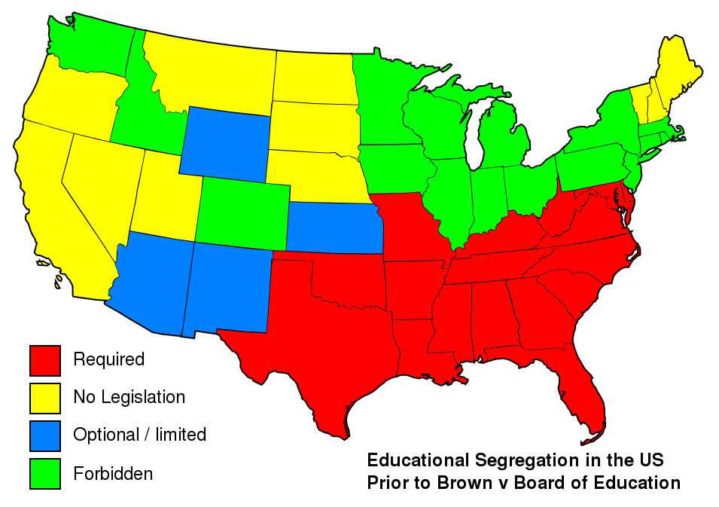
The Sixties: 1960-1969
Brown vs. Board of Education
Educational segregation in the US prior to Brown vs. Board of Education
Free to share, print, make copies and changes. Get yours at www.boundless.com
Wikipedia. "Brown v. Board of Education." CC BY-SA 3.0 http://en.wikipedia.org/wiki/Brown_v._Board_of_Education View on Boundless.com

Slide 13
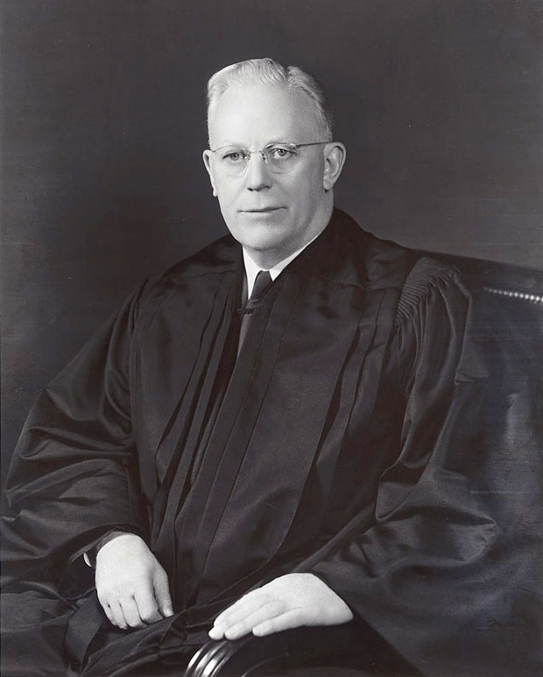
The Sixties: 1960-1969
Chief Justice Earl Warren
Warren was responsible for the decisive influence of the Supreme Court on rights in the 1960s
Free to share, print, make copies and changes. Get yours at www.boundless.com
Wikipedia. "Earl Warren." Public domain http://en.wikipedia.org/wiki/Earl_Warren View on Boundless.com

Slide 14
The Sixties: 1960-1969
1953 Supreme Court
The Supreme Court in 1953, with Chief Justice Earl Warren sitting center.
Free to share, print, make copies and changes. Get yours at www.boundless.com
Wikipedia. "Warren Court." Public domain http://en.wikipedia.org/wiki/Warren_Court View on Boundless.com

Slide 15
The Sixties: 1960-1969
JFK and Africa
John and Jackie Kennedy, along with Côte d'Ivoire President Félix Houphouët-Boigny and his wife, at a state dinner in the White House, 1962
Free to share, print, make copies and changes. Get yours at www.boundless.com
Wikipedia. "Foreign policy of the John F. Kennedy administration." Public domain http://en.wikipedia.org/wiki/Foreign_policy_of_the_John_F._Kennedy_administration View on Boundless.com

Slide 16
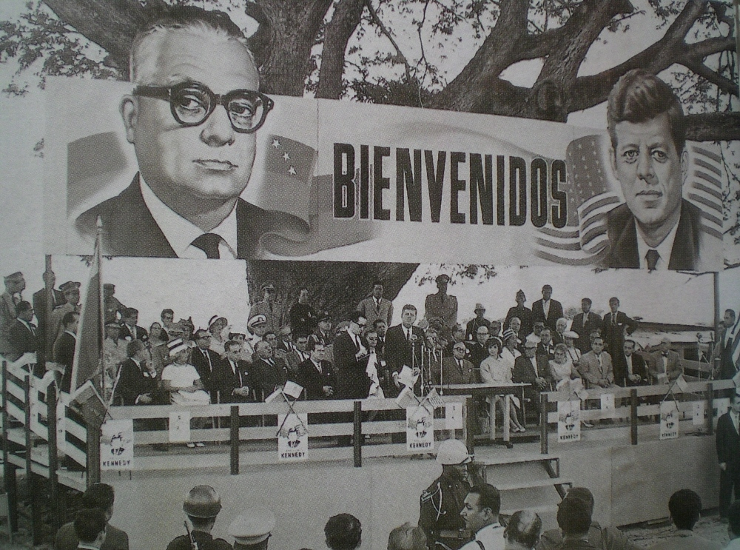
The Sixties: 1960-1969
Alliance for Progress
Venezuelan President Rómulo Betancourt and U.S. President John F. Kennedy at La Morita, Venezuela, during an official meeting for the Alliance for Progress in 1961.
Free to share, print, make copies and changes. Get yours at www.boundless.com
Wikipedia. "Alliance for Progress." Public domain http://en.wikipedia.org/wiki/Alliance_for_Progress View on Boundless.com

Slide 17
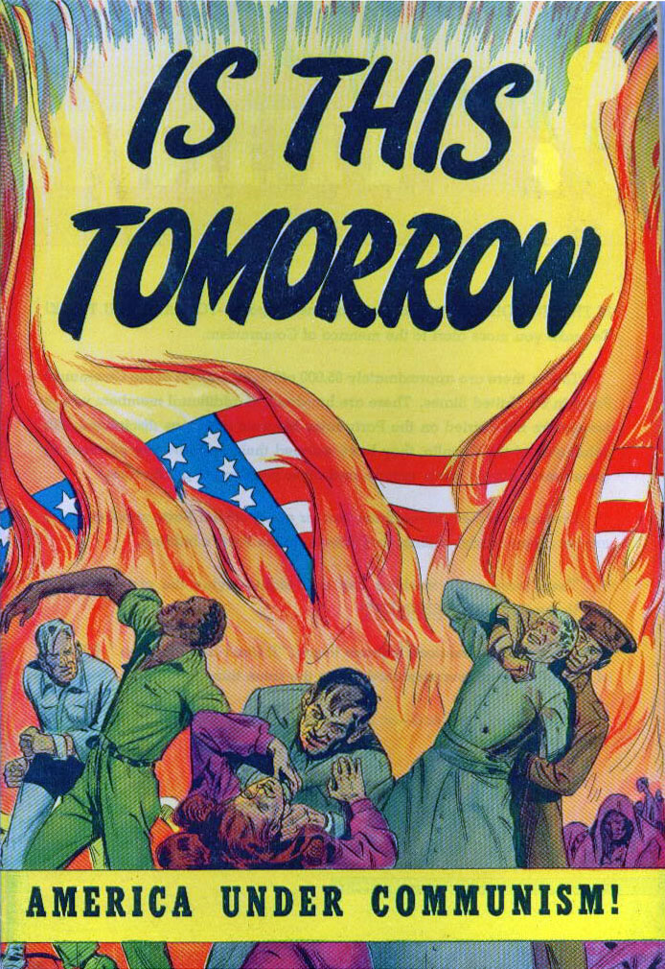
The Sixties: 1960-1969
This is Tomorrow
This propaganda book warns of the danger of a communist revolution—something that JFK's policy of containment sought to fight against.
Free to share, print, make copies and changes. Get yours at www.boundless.com
Wikipedia. "Is this tomorrow." Public domain http://en.wikipedia.org/wiki/File:Is_this_tomorrow.jpg View on Boundless.com

Slide 18
The Sixties: 1960-1969
Vienna Summit
John F. Kennedy meeting Nikita Khrushchev at the Vienna Summit in June, 1961.
Free to share, print, make copies and changes. Get yours at www.boundless.com
Wikipedia. "Vienna summit." Public domain http://en.wikipedia.org/wiki/Vienna_summit View on Boundless.com

Slide 19
The Sixties: 1960-1969
JFK's Funeral
An honor guard folds the flag of the United States at Arlington National Cemetery in preparation for flag presentation to Jacqueline Kennedy on November 25, 1963.
Free to share, print, make copies and changes. Get yours at www.boundless.com
Wikipedia. "State funeral of John F. Kennedy." Public domain http://en.wikipedia.org/wiki/State_funeral_of_John_F._Kennedy View on Boundless.com

Slide 20
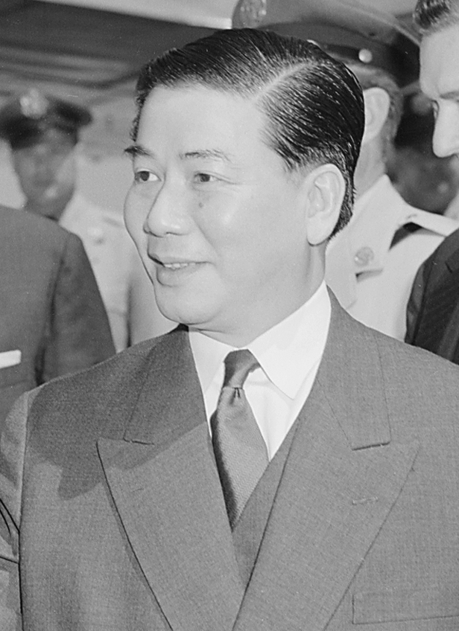
The Sixties: 1960-1969
South Vietnam President
President Ngo Dinh Diem of South Vietnam.
Free to share, print, make copies and changes. Get yours at www.boundless.com
Wikipedia. "1960 South Vietnamese coup attempt." Public domain http://en.wikipedia.org/wiki/1960_South_Vietnamese_coup_attempt View on Boundless.com

Slide 21
The Sixties: 1960-1969
South Vietnamese Troops
Operations against communist Viet Cong in Vietnam.
Free to share, print, make copies and changes. Get yours at www.boundless.com
Wikimedia. "ARVN in action HD-SN-99-02062." Public domain http://commons.wikimedia.org/wiki/File:ARVN_in_action_HD-SN-99-02062.JPEG View on Boundless.com

Slide 22
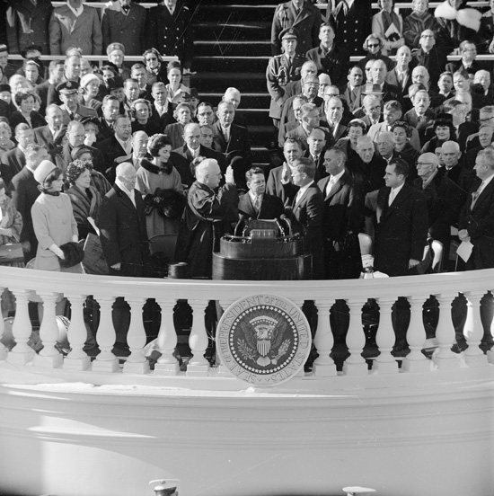
The Sixties: 1960-1969
JFK Inaguration
JFK is inaugurated, January 20, 1961.
Free to share, print, make copies and changes. Get yours at www.boundless.com
Wikipedia. "Jfk." Public domain http://en.wikipedia.org/wiki/Jfk#Presidency View on Boundless.com

Slide 23
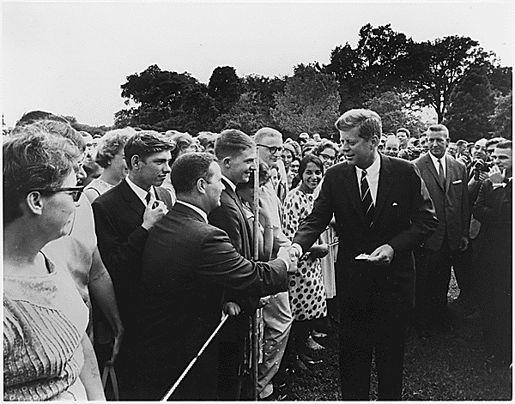
The Sixties: 1960-1969
Peace Corps
Kennedy greeting Peace Corps volunteers, 1961
Free to share, print, make copies and changes. Get yours at www.boundless.com
Wikimedia. "Kennedy greeting Peace Corps volunteers, 1961." Public domain http://commons.wikimedia.org/wiki/File:Kennedy_greeting_Peace_Corps_volunteers,_1961.jpg View on Boundless.com

Slide 24
The Sixties: 1960-1969
"Ask Not What Your Country Can Do For You"
In this short clip from his 1961 inaugural address, JFK delivers one of his most famous speeches
Free to share, print, make copies and changes. Get yours at www.boundless.com
View on Boundless.com

Slide 25
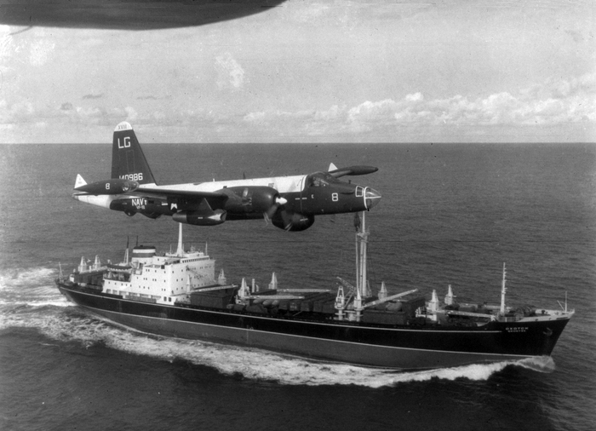
The Sixties: 1960-1969
Naval Blockade
A US Navy plane flying over a Soviet cargo ship during the Cuban Crisis
Free to share, print, make copies and changes. Get yours at www.boundless.com
Wikipedia. "Cuban Missile Crisis." Public domain http://en.wikipedia.org/wiki/Cuban_Missile_Crisis View on Boundless.com

Slide 26
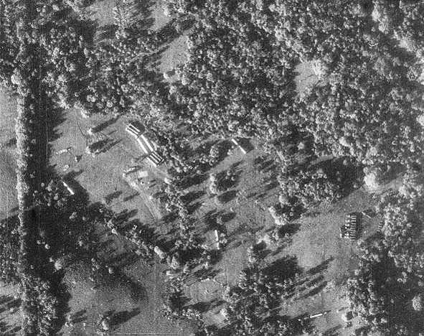
The Sixties: 1960-1969
Reconnaissance Photos
U-2 reconnaissance photograph of Soviet nuclear missiles in Cuba.Missile transports and tents for fueling and maintenance are visible
Free to share, print, make copies and changes. Get yours at www.boundless.com
Wikipedia. "Cuban Missile Crisis." Public domain http://en.wikipedia.org/wiki/Cuban_Missile_Crisis View on Boundless.com

Slide 27
The Sixties: 1960-1969
Containment of Cuba
JFK signs a proclamation that authorizes the naval containment of Cuba
Free to share, print, make copies and changes. Get yours at www.boundless.com
Wikipedia. "Kennedy Doctrine." Public domain http://en.wikipedia.org/wiki/Kennedy_Doctrine View on Boundless.com

Slide 28
The Sixties: 1960-1969
The Apollo program is perhaps the most famous of President Kennedy's initiatives, but while in office he also worked to achieve all of the following EXCEPT
A) the Peace Corps, to help underdeveloped nations with education, farming, and health care.
B) the Equal Pay Act, aimed at abolishing wage disparity based on sex.
C) the continuation of tight fiscal policies to drive up interest rates and slow economic growth.
D) the "New Frontier," which promised medical care for the elderly and economic aid to rural regions.
Free to share, print, make copies and changes. Get yours at www.boundless.com

Slide 29
The Sixties: 1960-1969
The Apollo program is perhaps the most famous of President Kennedy's initiatives, but while in office he also worked to achieve all of the following EXCEPT
A) the Peace Corps, to help underdeveloped nations with education, farming, and health care.
B) the Equal Pay Act, aimed at abolishing wage disparity based on sex.
C) the continuation of tight fiscal policies to drive up interest rates and slow economic growth.
D) the "New Frontier," which promised medical care for the elderly and economic aid to rural regions.
Free to share, print, make copies and changes. Get yours at www.boundless.com
Boundless - LO. "Boundless." CC BY-SA 3.0 http://www.boundless.com/

Slide 30
The Sixties: 1960-1969
The overall goal of Kennedy's policy toward the Soviet Union can best be summarized as
A) the reversal of Communist progress in the Western Hemisphere, articulated as the Kennedy Doctrine.
B) reconciliation, evinced by the provision of $53 million worth of food and medicine to Cuba.
C) dialog, as in June 1961 when leader Khrushchev agreed to negotiate a nuclear test ban treaty.
D) the containment communism at any cost, seen in his rhetoric and increased involvement in Vietnam.
Free to share, print, make copies and changes. Get yours at www.boundless.com

Slide 31
The Sixties: 1960-1969
The overall goal of Kennedy's policy toward the Soviet Union can best be summarized as
A) the reversal of Communist progress in the Western Hemisphere, articulated as the Kennedy Doctrine.
B) reconciliation, evinced by the provision of $53 million worth of food and medicine to Cuba.
C) dialog, as in June 1961 when leader Khrushchev agreed to negotiate a nuclear test ban treaty.
D) the containment communism at any cost, seen in his rhetoric and increased involvement in Vietnam.
Free to share, print, make copies and changes. Get yours at www.boundless.com
Boundless - LO. "Boundless." CC BY-SA 3.0 http://www.boundless.com/

Slide 32
The Sixties: 1960-1969
Kennedy's foreign policy toward the Third World was aimed improving the United States' standing. Which of the following initiatives were designed to advance that goal?
A) Under Kennedy, a civil rights activist was tasked with management of the African affairs.
B) The Alliance for Progress aimed to improve economic cooperation between the U.S. and Latin America.
C) Kennedy recognized the ambitious Pan-Arabic initiatives of Egypt's leader, Gamal Abdel Nasser.
D) All of these answers.
Free to share, print, make copies and changes. Get yours at www.boundless.com

Slide 33
The Sixties: 1960-1969
Kennedy's foreign policy toward the Third World was aimed improving the United States' standing. Which of the following initiatives were designed to advance that goal?
A) Under Kennedy, a civil rights activist was tasked with management of the African affairs.
B) The Alliance for Progress aimed to improve economic cooperation between the U.S. and Latin America.
C) Kennedy recognized the ambitious Pan-Arabic initiatives of Egypt's leader, Gamal Abdel Nasser.
D) All of these answers.
Free to share, print, make copies and changes. Get yours at www.boundless.com
Boundless - LO. "Boundless." CC BY-SA 3.0 http://www.boundless.com/

Slide 34
The Sixties: 1960-1969
Which of the following served to establish the Warren Court's reputation for liberal expansion of civil rights, civil liberties, judicial power, and federal power?
A) Gideon v. Wainwright, which held that indigent criminal defendants receive publicly-funded counsel.
B) All of these answers.
C) Brown v. Board of Education, which ended segregation in public schools.
D) Griswold v. Connecticut, which ruled that the Constitution protects a general right to privacy.
Free to share, print, make copies and changes. Get yours at www.boundless.com

Slide 35
The Sixties: 1960-1969
Which of the following served to establish the Warren Court's reputation for liberal expansion of civil rights, civil liberties, judicial power, and federal power?
A) Gideon v. Wainwright, which held that indigent criminal defendants receive publicly-funded counsel.
B) All of these answers.
C) Brown v. Board of Education, which ended segregation in public schools.
D) Griswold v. Connecticut, which ruled that the Constitution protects a general right to privacy.
Free to share, print, make copies and changes. Get yours at www.boundless.com
Boundless - LO. "Boundless." CC BY-SA 3.0 http://www.boundless.com/

Slide 36
The Sixties: 1960-1969
The immediate outcomes of the Cuban Missile Crisis included
A) all of these answers.
B) a direct communications link between Moscow and Washington, DC in the event of another such crisis.
C) the continued presence in Italy and Turkey of 100 U.S.-built nuclear missiles aimed at Moscow.
D) affirmation of mutual assured destruction via the continued deployment of Soviet missiles in Cuba.
Free to share, print, make copies and changes. Get yours at www.boundless.com

Slide 37
The Sixties: 1960-1969
The immediate outcomes of the Cuban Missile Crisis included
A) all of these answers.
B) a direct communications link between Moscow and Washington, DC in the event of another such crisis.
C) the continued presence in Italy and Turkey of 100 U.S.-built nuclear missiles aimed at Moscow.
D) affirmation of mutual assured destruction via the continued deployment of Soviet missiles in Cuba.
Free to share, print, make copies and changes. Get yours at www.boundless.com
Boundless - LO. "Boundless." CC BY-SA 3.0 http://www.boundless.com/

Slide 38
The Sixties: 1960-1969
U.S. involvement in the Vietnam War can best be understood in the larger context of
A) the assassination of South Vietnam's President Ngo Dinh Diem.
B) the blanket approval for presidential use of force in the Gulf of Tonkin Resolution.
C) the fact that no firm policy decision was made regarding Vietnam prior to Kennedy's assassination.
D) the policy of containment following several prominent U.S. failures to halt the spread of communism.
Free to share, print, make copies and changes. Get yours at www.boundless.com

Slide 39
The Sixties: 1960-1969
U.S. involvement in the Vietnam War can best be understood in the larger context of
A) the assassination of South Vietnam's President Ngo Dinh Diem.
B) the blanket approval for presidential use of force in the Gulf of Tonkin Resolution.
C) the fact that no firm policy decision was made regarding Vietnam prior to Kennedy's assassination.
D) the policy of containment following several prominent U.S. failures to halt the spread of communism.
Free to share, print, make copies and changes. Get yours at www.boundless.com
Boundless - LO. "Boundless." CC BY-SA 3.0 http://www.boundless.com/

Slide 40
The Sixties: 1960-1969
The Warren Commission arrived at which of the following conclusions after its ten-month investigation of the Kennedy assassination?
A) The President was assassinated by Lee Harvey Oswald acting alone.
B) Jack Ruby was working in cooperation with organized crime when he shot Lee Harvey Oswald.
C) Oswald was innocented, a patsy arrested because he had lived in the Soviet Union.
D) The President was assassinated as part of a larger cover-up hidden from the American public.
Free to share, print, make copies and changes. Get yours at www.boundless.com

Slide 41
The Sixties: 1960-1969
The Warren Commission arrived at which of the following conclusions after its ten-month investigation of the Kennedy assassination?
A) The President was assassinated by Lee Harvey Oswald acting alone.
B) Jack Ruby was working in cooperation with organized crime when he shot Lee Harvey Oswald.
C) Oswald was innocented, a patsy arrested because he had lived in the Soviet Union.
D) The President was assassinated as part of a larger cover-up hidden from the American public.
Free to share, print, make copies and changes. Get yours at www.boundless.com
Boundless - LO. "Boundless." CC BY-SA 3.0 http://www.boundless.com/

Slide 42
Attribution
The Sixties: 1960-1969
Wikipedia. "Warren Court." CC BY-SA 3.0 http://en.wikipedia.org/wiki/Warren_Court
Wikipedia. "Earl Warren." CC BY-SA 3.0 http://en.wikipedia.org/wiki/Earl%20Warren
Wikipedia. "Warren Court." CC BY-SA 3.0 http://en.wikipedia.org/wiki/Warren%20Court
Wikipedia. "Brown v. Board of Education." CC BY-SA 3.0 http://en.wikipedia.org/wiki/Brown%20v.%20Board%20of%20Education
Wikipedia. "Alliance for Progress." CC BY-SA 3.0 http://en.wikipedia.org/wiki/Alliance_for_Progress
Wikipedia. "John F. Kennedy." CC BY-SA 3.0 http://en.wikipedia.org/wiki/John_F._Kennedy
Wikipedia. "Foreign policy of the John F. Kennedy administration." CC BY-SA 3.0 http://en.wikipedia.org/wiki/Foreign_policy_of_the_John_F._Kennedy_administration
Wikipedia. "Alliance for Progress." CC BY-SA 3.0 http://en.wikipedia.org/wiki/Alliance%20for%20Progress
Wikipedia. "African Nationalism." CC BY-SA 3.0 http://en.wikipedia.org/wiki/African%20Nationalism
Wikipedia. "Gamal Abdel Nasser." CC BY-SA 3.0 http://en.wikipedia.org/wiki/Gamal%20Abdel%20Nasser
Wikipedia. "Kennedy Doctrine." CC BY-SA 3.0 http://en.wikipedia.org/wiki/Kennedy_Doctrine
Wikipedia. "John F. Kennedy." CC BY-SA 3.0 http://en.wikipedia.org/wiki/John_F._Kennedy
Wikipedia. "Kennedy Doctrine." CC BY-SA 3.0 http://en.wikipedia.org/wiki/Kennedy%20Doctrine
Wikipedia. "Berlin Crisis of 1961." CC BY-SA 3.0 http://en.wikipedia.org/wiki/Berlin%20Crisis%20of%201961
Wikipedia. "Bay of Pigs Invasion." CC BY-SA 3.0 http://en.wikipedia.org/wiki/Bay%20of%20Pigs%20Invasion
Wikipedia. "John F. Kennedy." CC BY-SA 3.0 http://en.wikipedia.org/wiki/John_F._Kennedy
Wikipedia. "Assassination of John F. Kennedy." CC BY-SA 3.0 http://en.wikipedia.org/wiki/Assassination_of_John_F._Kennedy
Free to share, print, make copies and changes. Get yours at www.boundless.com

Slide 43
The Sixties: 1960-1969
Wikipedia. "John F. Kennedy." CC BY-SA 3.0 http://en.wikipedia.org/wiki/John_F._Kennedy#Assassination
Wikipedia. "Lee Harvey Oswald." CC BY-SA 3.0 http://en.wikipedia.org/wiki/Lee%20Harvey%20Oswald
Wikipedia. "Jack Ruby." CC BY-SA 3.0 http://en.wikipedia.org/wiki/Jack%20Ruby
Wikipedia. "Warren Commission." CC BY-SA 3.0 http://en.wikipedia.org/wiki/Warren%20Commission
Wikipedia. "Vietnam War." CC BY-SA 3.0 http://en.wikipedia.org/wiki/Vietnam_War#During_John_F._Kennedy.27s_administration.2C_1961.E2.80.931963
Wikipedia. "Foreign policy of the John F. Kennedy administration." CC BY-SA 3.0 http://en.wikipedia.org/wiki/Foreign_policy_of_the_John_F._Kennedy_administration
Wikipedia. "Ngo Dinh Diem." CC BY-SA 3.0 http://en.wikipedia.org/wiki/Ngo%20Dinh%20Diem
Wikipedia. "Military Assistance Command Vietnam." CC BY-SA 3.0 http://en.wikipedia.org/wiki/Military%20Assistance%20Command%20Vietnam
Wikipedia. "Foreign Assistance Act of 1962." CC BY-SA 3.0 http://en.wikipedia.org/wiki/Foreign%20Assistance%20Act%20of%201962
Wikipedia. "Role of the United States in the Vietnam War." CC BY-SA 3.0 http://en.wikipedia.org/wiki/Role_of_the_United_States_in_the_Vietnam_War#John_F._Kennedy_.281961.E2.80.931963.29
Wikipedia. "Military history of the United States." CC BY-SA 3.0 http://en.wikipedia.org/wiki/Military_history_of_the_United_States#Vietnam_War_.281955.E2.80.931975.29
Wikipedia. "Jfk." CC BY-SA 3.0 http://en.wikipedia.org/wiki/Jfk#Presidency
Wikipedia. "New Frontier." CC BY-SA 3.0 http://en.wikipedia.org/wiki/New%20Frontier
Wikipedia. "Immigration and Nationality Act of 1965." CC BY-SA 3.0 http://en.wikipedia.org/wiki/Immigration%20and%20Nationality%20Act%20of%201965
Wiktionary. "containment." CC BY-SA 3.0 http://en.wiktionary.org/wiki/containment
Wikipedia. "Cuban Missile Crisis." CC BY-SA 3.0 http://en.wikipedia.org/wiki/Cuban_Missile_Crisis
Wiktionary. "blockade." CC BY-SA 3.0 http://en.wiktionary.org/wiki/blockade
Wikipedia. "Cuban Missile Crisis." CC BY-SA 3.0 http://en.wikipedia.org/wiki/Cuban%20Missile%20Crisis
Wikipedia. "Hotline Agreement." CC BY-SA 3.0 http://en.wikipedia.org/wiki/Hotline%20Agreement
Free to share, print, make copies and changes. Get yours at www.boundless.com

