Slide 1
The Mexican-American War
James K. Polk
The Manifest Destiny President

Slide 2
The TEXAS Dilemma
Lone Star Rebellion
Upon Mexican independence, American Stephen Austin was granted a huge settlement in 1823. Conditions:
Limited to 300 families
Convert to Catholicism
20,000 Americans by 1830 – Mexico halted immigration
1835 – Texans took the Alamo
Santa Anna destroyed them
1836 – Sam Houston led victory at San Jacinto = Independence
The Republic of Texas annually applied for statehood
Jackson, and then Van Buren administrations tried to avoid the controversy over annexation of a rogue, slave state.
Statehood was denied for 10 years

Slide 3
President James K. Polk
Democrat from Tennessee (2 term Governor)
Was Speaker of the House of Representatives (4 years)
Was surprise, “Dark Horse” nominee for pres. In 1844
Ran on an expansionist Manifest Destiny platform promising the “Reannexation of Texas” and the “Reoccupation of Oregon.”
Defeated Whig Henry Clay in close election (170 EV to 105 EV)

Slide 4
Annexation of Texas
From 1836 on, Mexico considered Texas a “province in revolt.”
Britain hoped to see Texas remain independent.
Free trade (especially cotton)
Weaken the American economy
After Polk’s election, lame-duck President Tyler wanted to strengthen his legacy by annexing Texas.
Tyler avoided the 2/3 treaty ratification requirement in the Senate by arranging for a joint resolution (simple majority in both houses.) - This helped him sidestep the “conscience Whigs” objections.

Slide 5
President James K. Polk
Agenda
Lower Tariffs (The Walker Tariff 1846 lowered the rates from 32% to 25%.) Passed against strong opposition from the middle and northern states.
Restored the Independent Treasury that the Whigs had dropped in the previous administration.
Wanted to acquire California

Slide 6
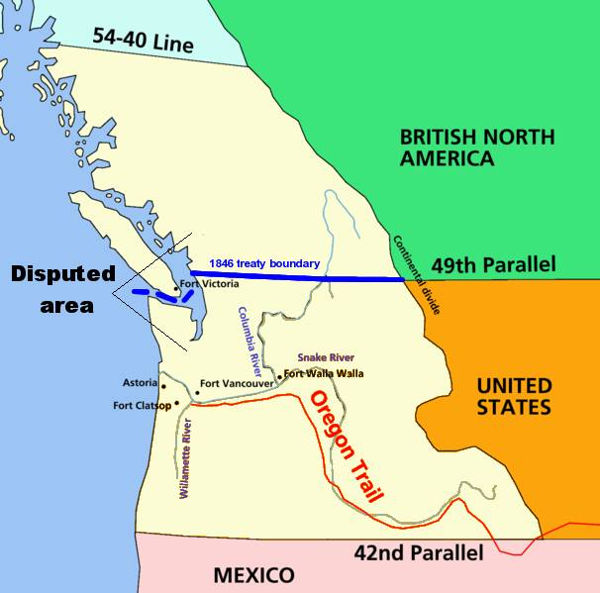
President James K. Polk
Wanted to settle Oregon dispute.
His party platform was for the “whole” of Oregon. “54 40’or fight!”
Polk proposed the compromise line of 49 degrees.
Britain eventually gave up on the Puget Sound claim.

Slide 7
Conflicts with Mexico
California
Sparsely populated in 1845. Mostly Indians, about 13,000 Spanish Mexicans, and a few thousand Americans.
Polk tried to buy the land. John Slidell was sent to Mexico City to offer up to $25 million but was not permitted to make his “insulting proposal.”
Rumors (mostly unfounded) were spreading that Britain was about to purchase the land.

Slide 8
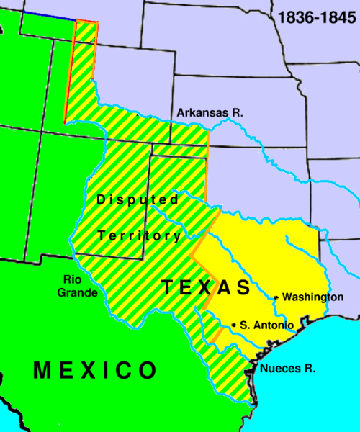
Conflicts with Mexico
Texas Border
After annexation, dispute over border. Nueces River or Rio Grande?
Polk sent General Zachary Taylor to the Rio Grande expecting the Mexicans to engage.

Slide 9
War with Mexico
April 25, 1846, Mexican troops crossed the Rio Grande and attacked Taylor’s forces with 16 killed or wounded.
Polk was going to ask Congress for a war declaration on the shaking claims of unpaid debts and Slidell’s rejections but now claimed the shedding of “American blood on American Soil.”
The Whigs put up a strong opposition suggesting that it was a land grab to expand slavery.
Congressman Abraham “spotty” Lincoln proposed several “spot resolutions” demanding to know the exact “spot” that blood was shed on American soil.

Slide 10
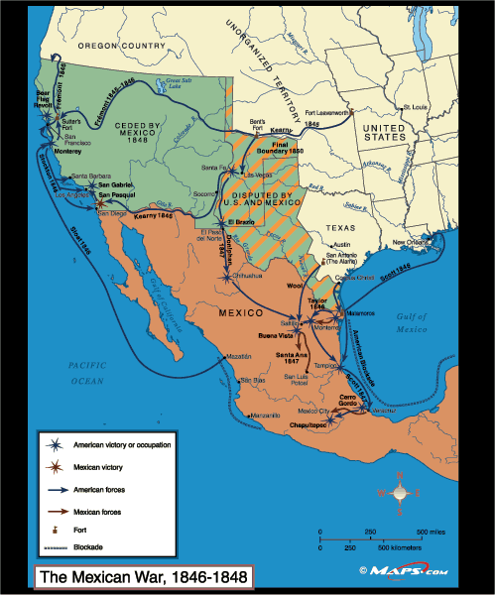
Mexican-American War
As war broke out, the Americans coordinated a coinciding (Bear Flag) revolt in California with full intensions of annexing the land at war’s end.
General Stephen W. Kearney & Captain John C. Fremont led the successful campaign
Gen. Zachary Taylor led the main attack in northern Mexico. (Key victories at Monterey & Buena Vista)
The decisive campaign was led by General Winfield Scott who landed at Vera Cruz and marched to and conquered Mexico City.

Slide 11
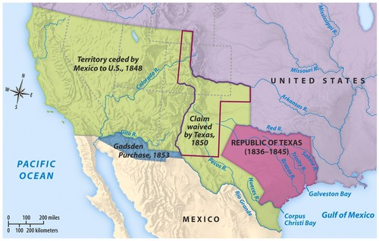
Treaty of Guadalupe Hidalgo
The Treaty officially ended the war on February 2, 1848
Chief clerk of the State Department, Nicolas Trist, negotiated the treaty.
Terms:
Confirmed the American title to Texas
Ceded the southwest, including California, to the U. S.
The U. S. forgave $3.25 million in Mexican debt & paid $ 15 million for the ceded land.

Slide 12
Impact of the War
Positive
Negative
Relatively limited casualties
Counting Texas, was largest land acquisition in American history
Future civil war leaders gained battlefield experience
Annapolis naval academy established in 1846
Military successes rebuffed foreign skeptics
War was an ugly turning point in relations with Mexico and Latin America as a whole
Intensified the slavery issue
Conscience Whigs & abolitionists claimed the southern “slavocracy” provoked the war for evil purposes
Wilmot Priviso 1846 furthered the tensions

