Slide 1
The Battle for
North America
The French and Indian War (Seven Years War)
and its impact on Colonial unity & loyalty
1754--1763

Slide 2
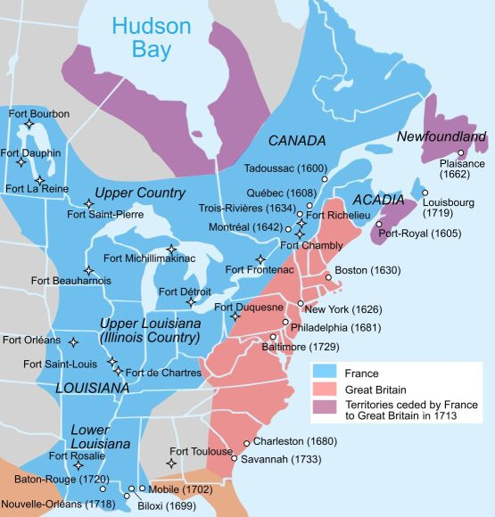
New France
Fur Trade
Relations with Indians
Louisiana
Threat to British Colonies

Slide 3
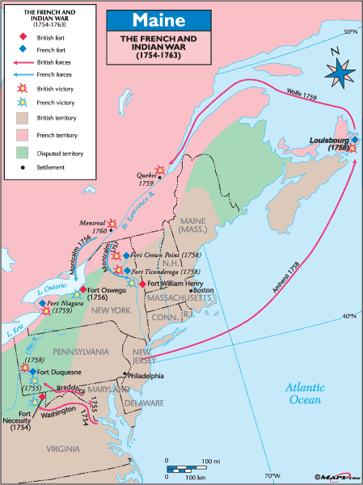
Washington vs. the French in Ohio 1754
Led Virginia militia in attempt to drive French from Ohio
(see map)
Ft. Necessity
Failure led to Albany Congress

Slide 4
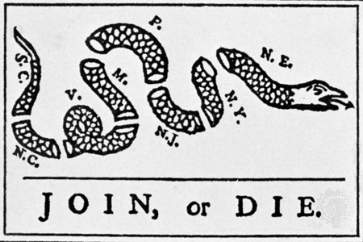
Albany Plan 1754
Immediate purpose
Long-range purpose
Franklin’s motive
Colonial concerns/British concerns

Slide 5
Braddock at Fort Duquesne (1755)
With Washington under his command
Failed to take Fort Duquesne
Limited participation from colonists
Many Indians allied with French for fear of British expansion

Slide 6
William Pitt and the Battle of Quebec (1759)
Pitt changed strategy and sent James Wolfe to attack this important cliff fortress
200 ships & 18,000 men
Goal: cut off French supply routes to all of New France
Defeated Marquis de Montcalm (both leaders killed)
THE turning point in the war

Slide 7
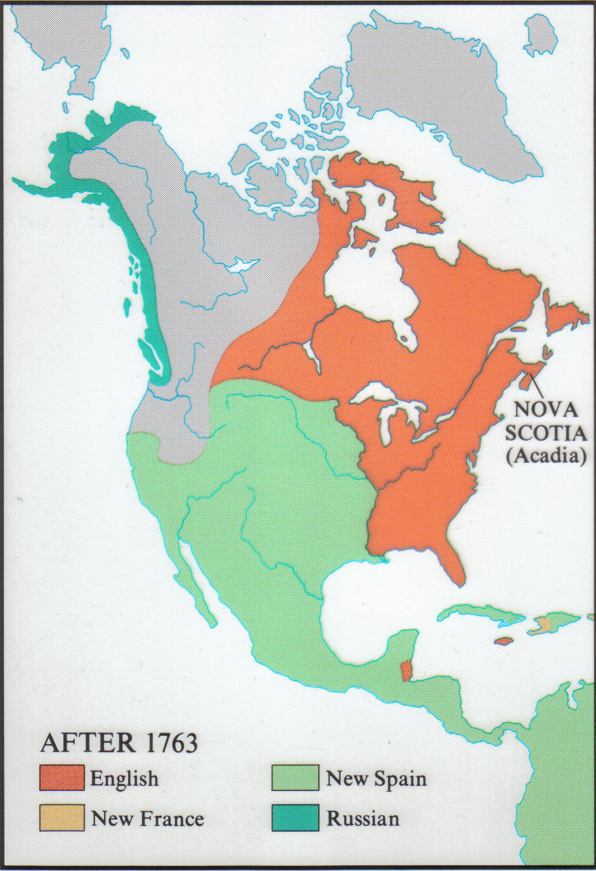
The Treaty of Paris 1763
British gains
France driven from continent
Spanish concessions (Louisiana)
(see map)

Slide 8
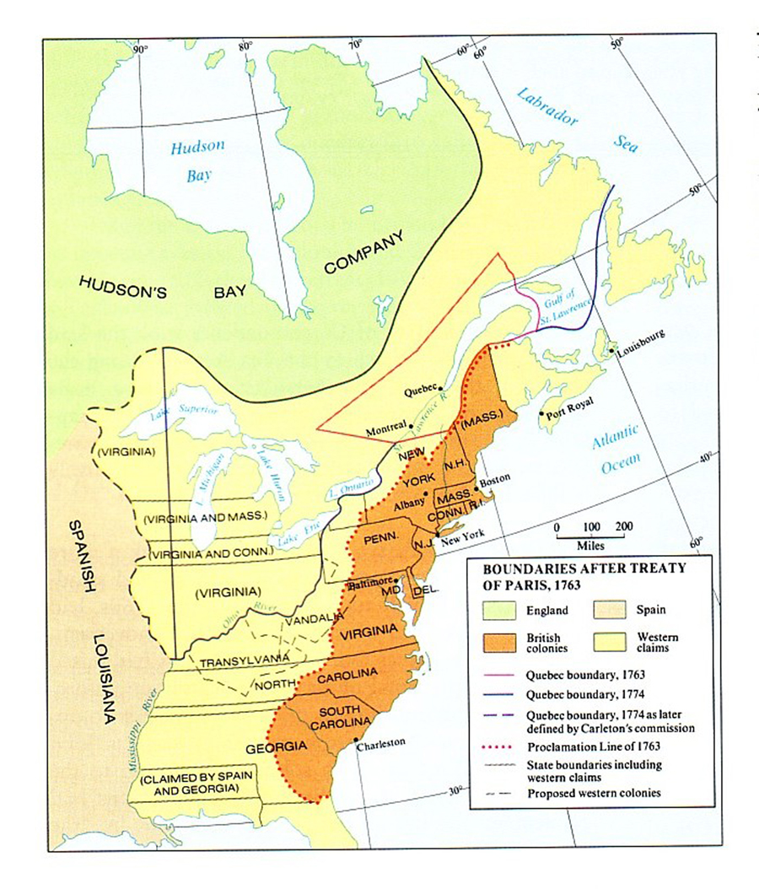
The Proclamation of 1763
Why? – Pontiac’s uprising & Spanish & Indian menaces in the southern frontier
American perception & response

