Slide 1
The
“Era of Good Feelings”
From Post-War Nationalism
To
The Emergence of Sectionalism

Slide 2
Nationalism
The perceived “victory” in the War of 1812 led to a growing sense of national unity and pride
The “death” of the Federalist Party (a result of the “victory” & revelations of the Hartford Convention) also contributed to the sense of “good feelings”
New national heroes (Harrison, Perry, Jackson) and folklore (songs, art, legends) emerged
Short-lived as sectional tensions (north/south/west) led to new political conflicts

Slide 3
The American System
Kentucky Senator Henry Clay used his leverage as the leading western senator to implement economic programs that would benefit the west (and arguably the nation).
Key components:
  Build canals (including Erie) & trans-Appalachian roads
  Renew the National Bank (20 year charter set to expire)
  Protective Tariffs (1816 – roughly 20-25%)

Slide 4
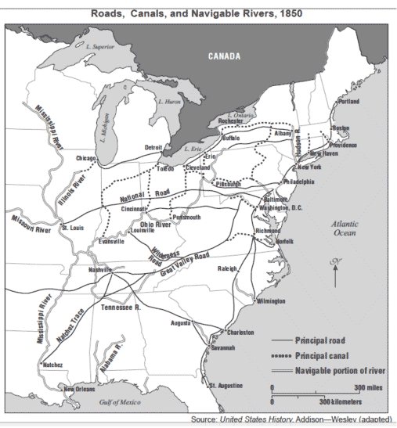
The American System

Slide 5
The American System
The plan faced opposition in both the north & south
North
  The 2nd Bank of the U. S. and the protective tariffs were favorable to northern businessmen
  However, the National Road concerned them as they feared loss of population and therefore laborers and consumers to the west
South
  The national bank was never popular with southerners and the protective tariffs, they feared, would led to retaliatory tariffs on their newly profitable cotton.
  Generally objected to the federal government spending on programs that they believed would only benefit certain states. Madison even vetoed believing it unconstitutional

Slide 6
President James Monroe
2 Terms (1817-1825)
4th Virginian elected president (3rd consecutive)
Crushed the Federalists for the final time, thus “enjoyed” a one-party presidency
Best known for foreign policy including the Monroe Doctrine
Dealt with the Panic of 1819

Slide 7
Sectionalism
As western states were added, the delicate political balance of northern industrial and southern agricultural interests was at stake.
The Trans-Alleghany states were becoming interdependent with the northeast and cotton began to dominate new southern states.
Slavery became the defining factor – symbolic of the economic foundations of the north and south.
Tensions grew over the status of slavery in each new state.

Slide 8
Missouri Compromise
Conflict:
  When Missouri applied for statehood in 1820, it did so as a “slave state” despite the fact that most of it’s residence did not own slaves.
  If admitted, the nation, and the Senate, would have 11 slave states and 10 “free” states.
  With a majority of the population and congressional representation, northern states blocked admittance as they feared the south would pass legislation more favorable to the southern agricultural interests including lowering or eliminating protective tariffs.

Slide 9
Missouri Compromise
Compromise:
  3 sectional “giants” emerged to hold the nation together over this divisive issue
    Henry Clay (Kentucky)
    Daniel Webster (Mass.)
    John C. Calhoun (South Carolina)
  Settlement:
    Missouri added as a slave state
    Maine (previously part of Massachusetts) became a free state
    In the territories, slavery was to be banned above the 36-30 line and permitted below

Slide 10
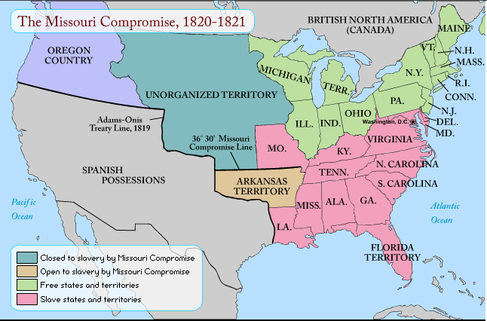
Missouri Compromise

